Slide 1

Metabolic interactions and capabilities within microbial communities
Gregory Medlock
Advisor: Jason Papin, PhD
Committee: Kevin Janes, PhD (Chair)
Peter Kasson, MD, PhD
Mete Civelek, PhD
William Petri, MD, PhD

Slide 2
Why the microbiome?
State of the field
Moving forward

Slide 3
Why the microbiome?
State of the field
Moving forward

Slide 4
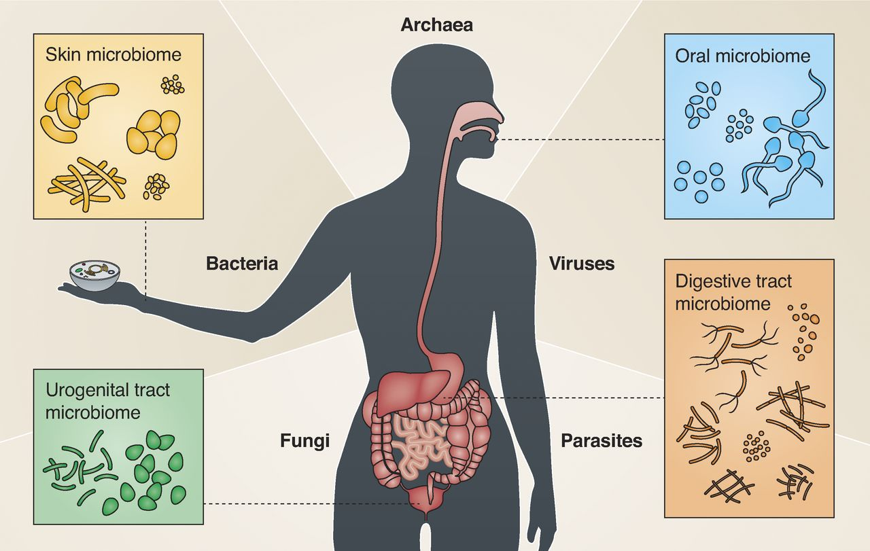
Microbes cause diseases ...
Microbes enable:
Immune system development
Digestion
Protection from infectious diseases
Together, the host and microbes are a microbiome. All of the strains of microbial organisms inhabiting a host are the microbiota.
... yet are essential for human life
Image: Garrett, JCB 2015
Background | Aim 1: metabolic interactions | Aim 2: metabolic capabilities | Conclusions
Notes:
Since the creation of the germ theory of disease, humans have appreciated microbes as pathogens that wreak havoc. They take advantage of the resources provided by the human environment to grow and spread. Only in the last few decades has widespread appreciation of the impact of non-pathogenic microbes on human health developed, and we’ve found that these microbes are truly essential for human life. The non-pathogenic bacteria colonize sites across the human body, such as the skin, urogenital tract, oral cavity, and the gut. We’ve found that they influence immune system development, and experiments with mice have demonstrated that absence of microbiota, the microbial communities that inhabit us, makes their immune system non-functional in many ways. Our microbiota also help with digestion, processing fiber that we consume and transforming it into metabolites we can harvest energy from. And they also preotect us from infectious diseases, competing with or otherwise inhibiting the growth pf pathogens.

Slide 5
Why the microbiome?
State of the field
Moving forward

Slide 6
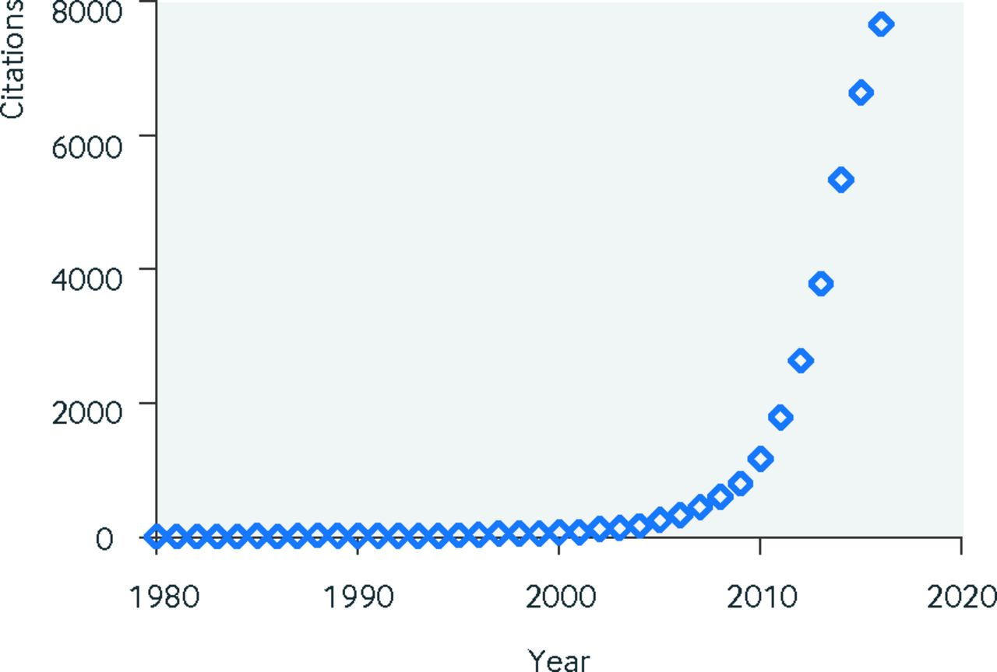
Exponential growth of microbiome research
1980s: regions of conserved genes used to identify bacterial species (Carl Woese)
Idea:
All bacteria need this gene.
Evolution introduces changes to some parts of the gene.
# of publications
Year
Image: Young, BMJ 2017
Background | Aim 1: metabolic interactions | Aim 2: metabolic capabilities | Conclusions

Slide 7
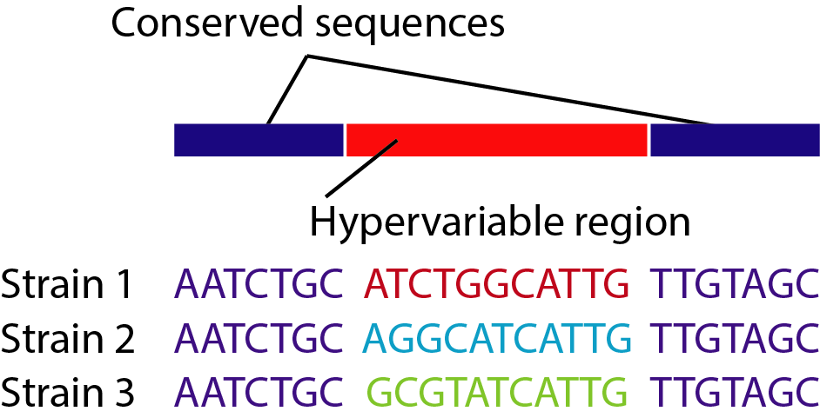
Identifying bacterial species with a single gene
Can tell different species apart using similarity of sequences.
Can quantify the amount of each species based on amount of DNA with each sequence.
Background | Aim 1: metabolic interactions | Aim 2: metabolic capabilities | Conclusions

Slide 8
Exponential growth of microbiome research
2003: Human genome project completed.
Enabled cheap & rapid DNA sequencing for microbes, too.
# of publications
Year
Image: Young, BMJ 2017
Background | Aim 1: metabolic interactions | Aim 2: metabolic capabilities | Conclusions

Slide 9
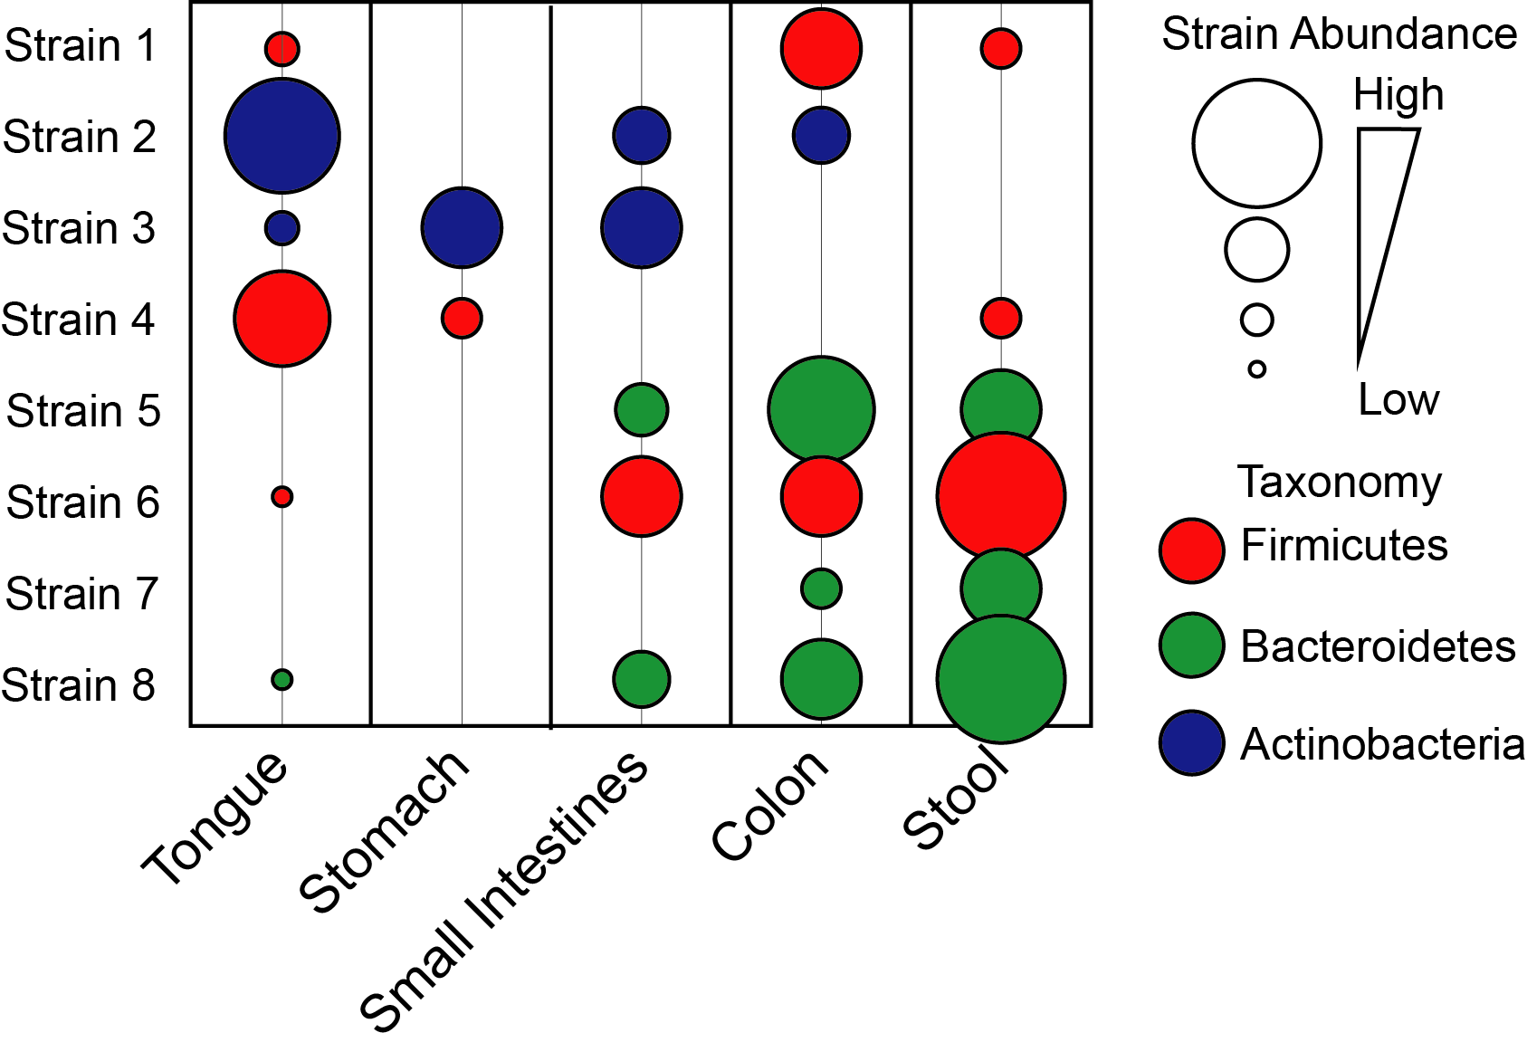
Cheap DNA sequencing enabled microbiome profiling
Microbiome-disease associations identified:
Irritable bowel disease
Obesity
Anxiety
Colon cancer
Infectious diseases
These associations usually involve microbes in the gut
Background | Aim 1: metabolic interactions | Aim 2: metabolic capabilities | Conclusions

Slide 10
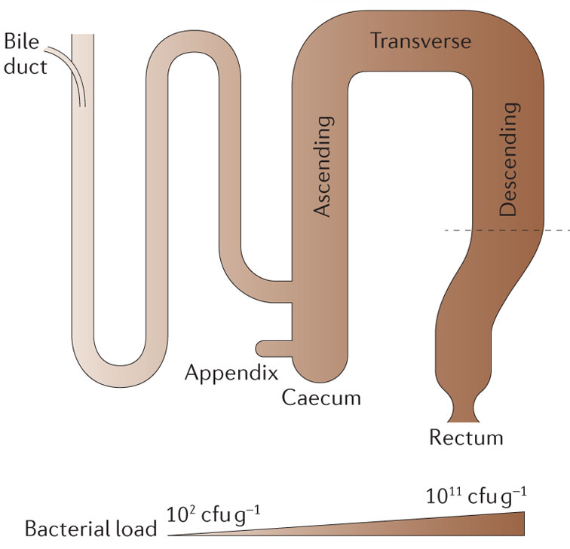
Why are gut microbes associated with disease?
Gut: exposed environment to extract energy from food, which brings...
Enemies: pathogens causing food poisoning, diarrheal diseases, etc.
Friends: help us digest food, fight pathogens, prevent cancer
Image: Donaldson et al., Nat Rev Micro 2016
Background | Aim 1: metabolic interactions | Aim 2: metabolic capabilities | Conclusions

Slide 11
Why the microbiome?
State of the field
Moving forward

Slide 12
If the microbiota is associated with disease, we should be able to treat disease by manipulating the microbiota itself
Probiotics: live microbes intended to treat or cure a disease or condition
To date, there are zero FDA-approved probiotics.
Why have they all failed?
Background | Aim 1: metabolic interactions | Aim 2: metabolic capabilities | Conclusions

Slide 13
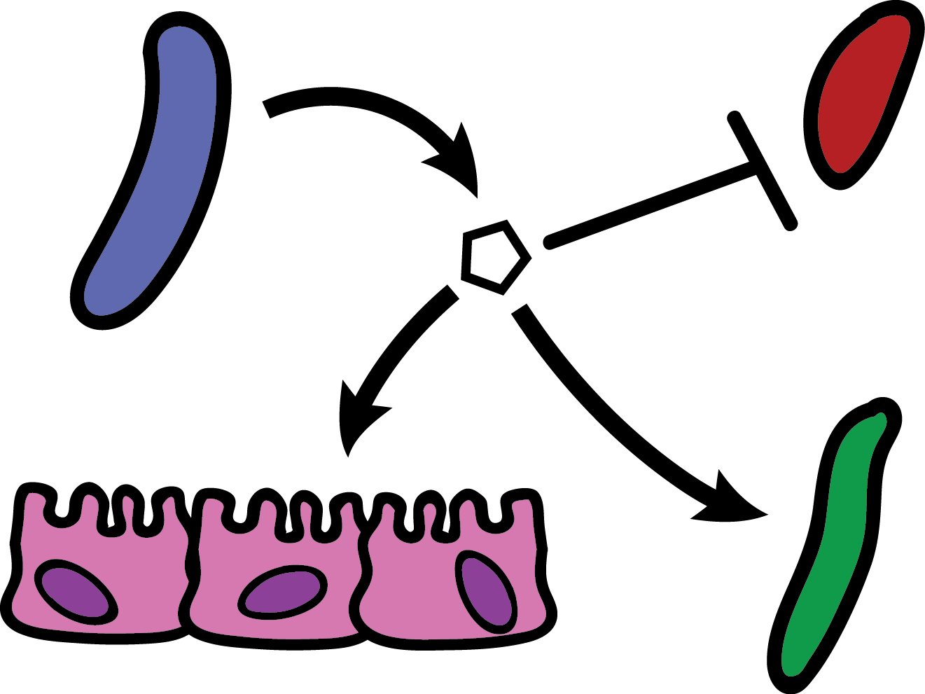
What determines microbiome function?
Interspecies interactions (host-microbe and microbe-microbe)
Interactions can be inferred by measuring population sizes and identifying correlations...
To design effective microbiome therapies, we need to determine the mechanisms governing these interactions.
Background | Aim 1: metabolic interactions | Aim 2: metabolic capabilities | Conclusions
Notes:
So, what determines the overall function of the microbiome?
The answer is the combination of interspecies interactions between members of the community and their host. The presence or absence of these interactions can be inferred from population size measurements, as is popular using amplicon sequencing techniques and metagenomics, but we really lack methods that determine the mechanism governing these population-shifting interactions.

Slide 14
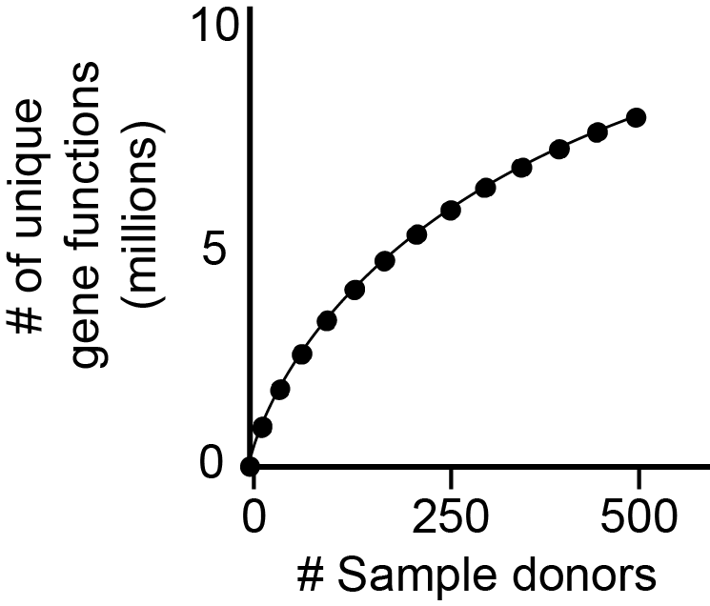
The functions performed by individual gut microbes are vast and largely unknown
Across all human gut microbiota, there are >10 million unique genes
Only ~20-40% of these genes can be assigned functions at any level
To design effective microbiome therapies, we need to determine the functions carried out by individual gut microbes
Qin et al., Nature 2010 & Lloyd-Price et al., Nature 2017
Background | Aim 1: metabolic interactions | Aim 2: metabolic capabilities | Conclusions
Notes:
Although these phenomena have been identified in several cases, mechanistic insight into the function of microbiomes is elusive, which makes controlling the function of microbiomes difficult.
Humans contain hundreds to a thousand bacterial species in their gut, and their behavior is dependent on a dizzying array of factors.
To make the situation even more dire, only 20-40% of bacterial genes within a microbiome can generally be assigned function. Furthermore, our inability to saturate the full diversity of genes present in samples from cohorts of hundreds of humans indicates that there are still genes of unknown function that we have yet to identify.

Slide 15
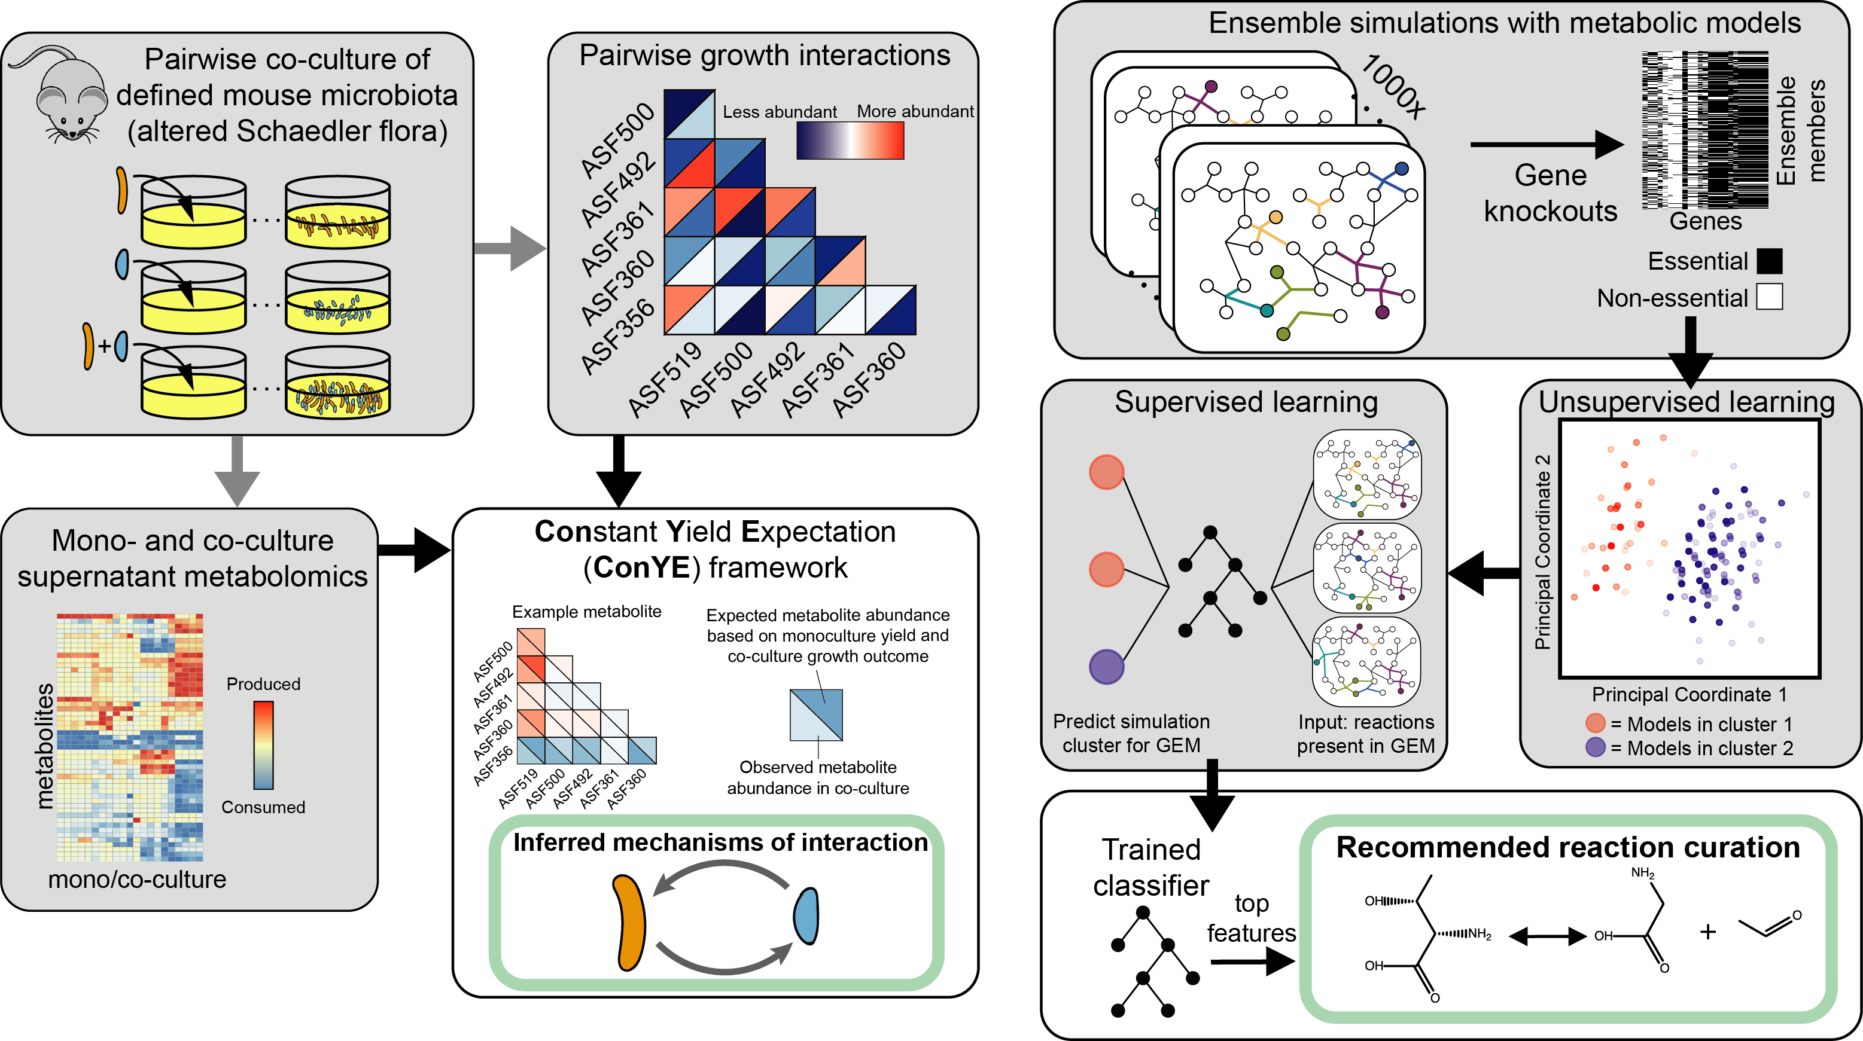
Dissertation Aims
Aim 1:
inferring metabolic interactions
between gut microbes
Aim 2:
Prioritize metabolic characterization of microbes

Slide 16
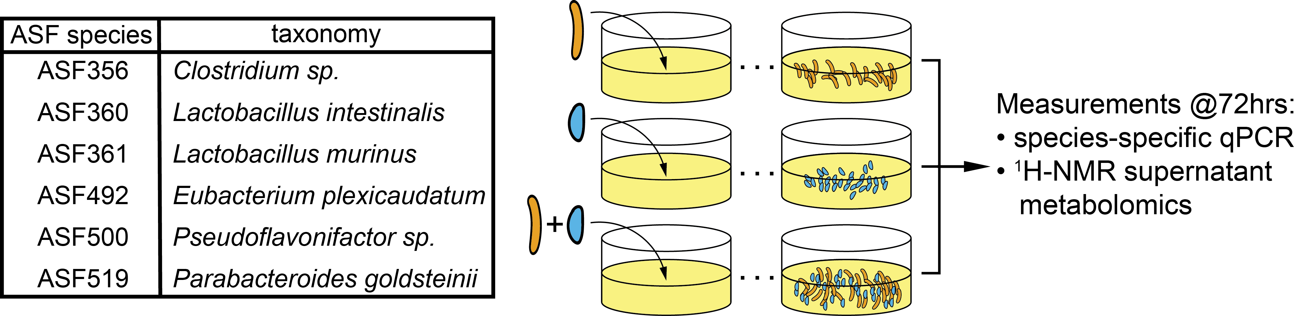

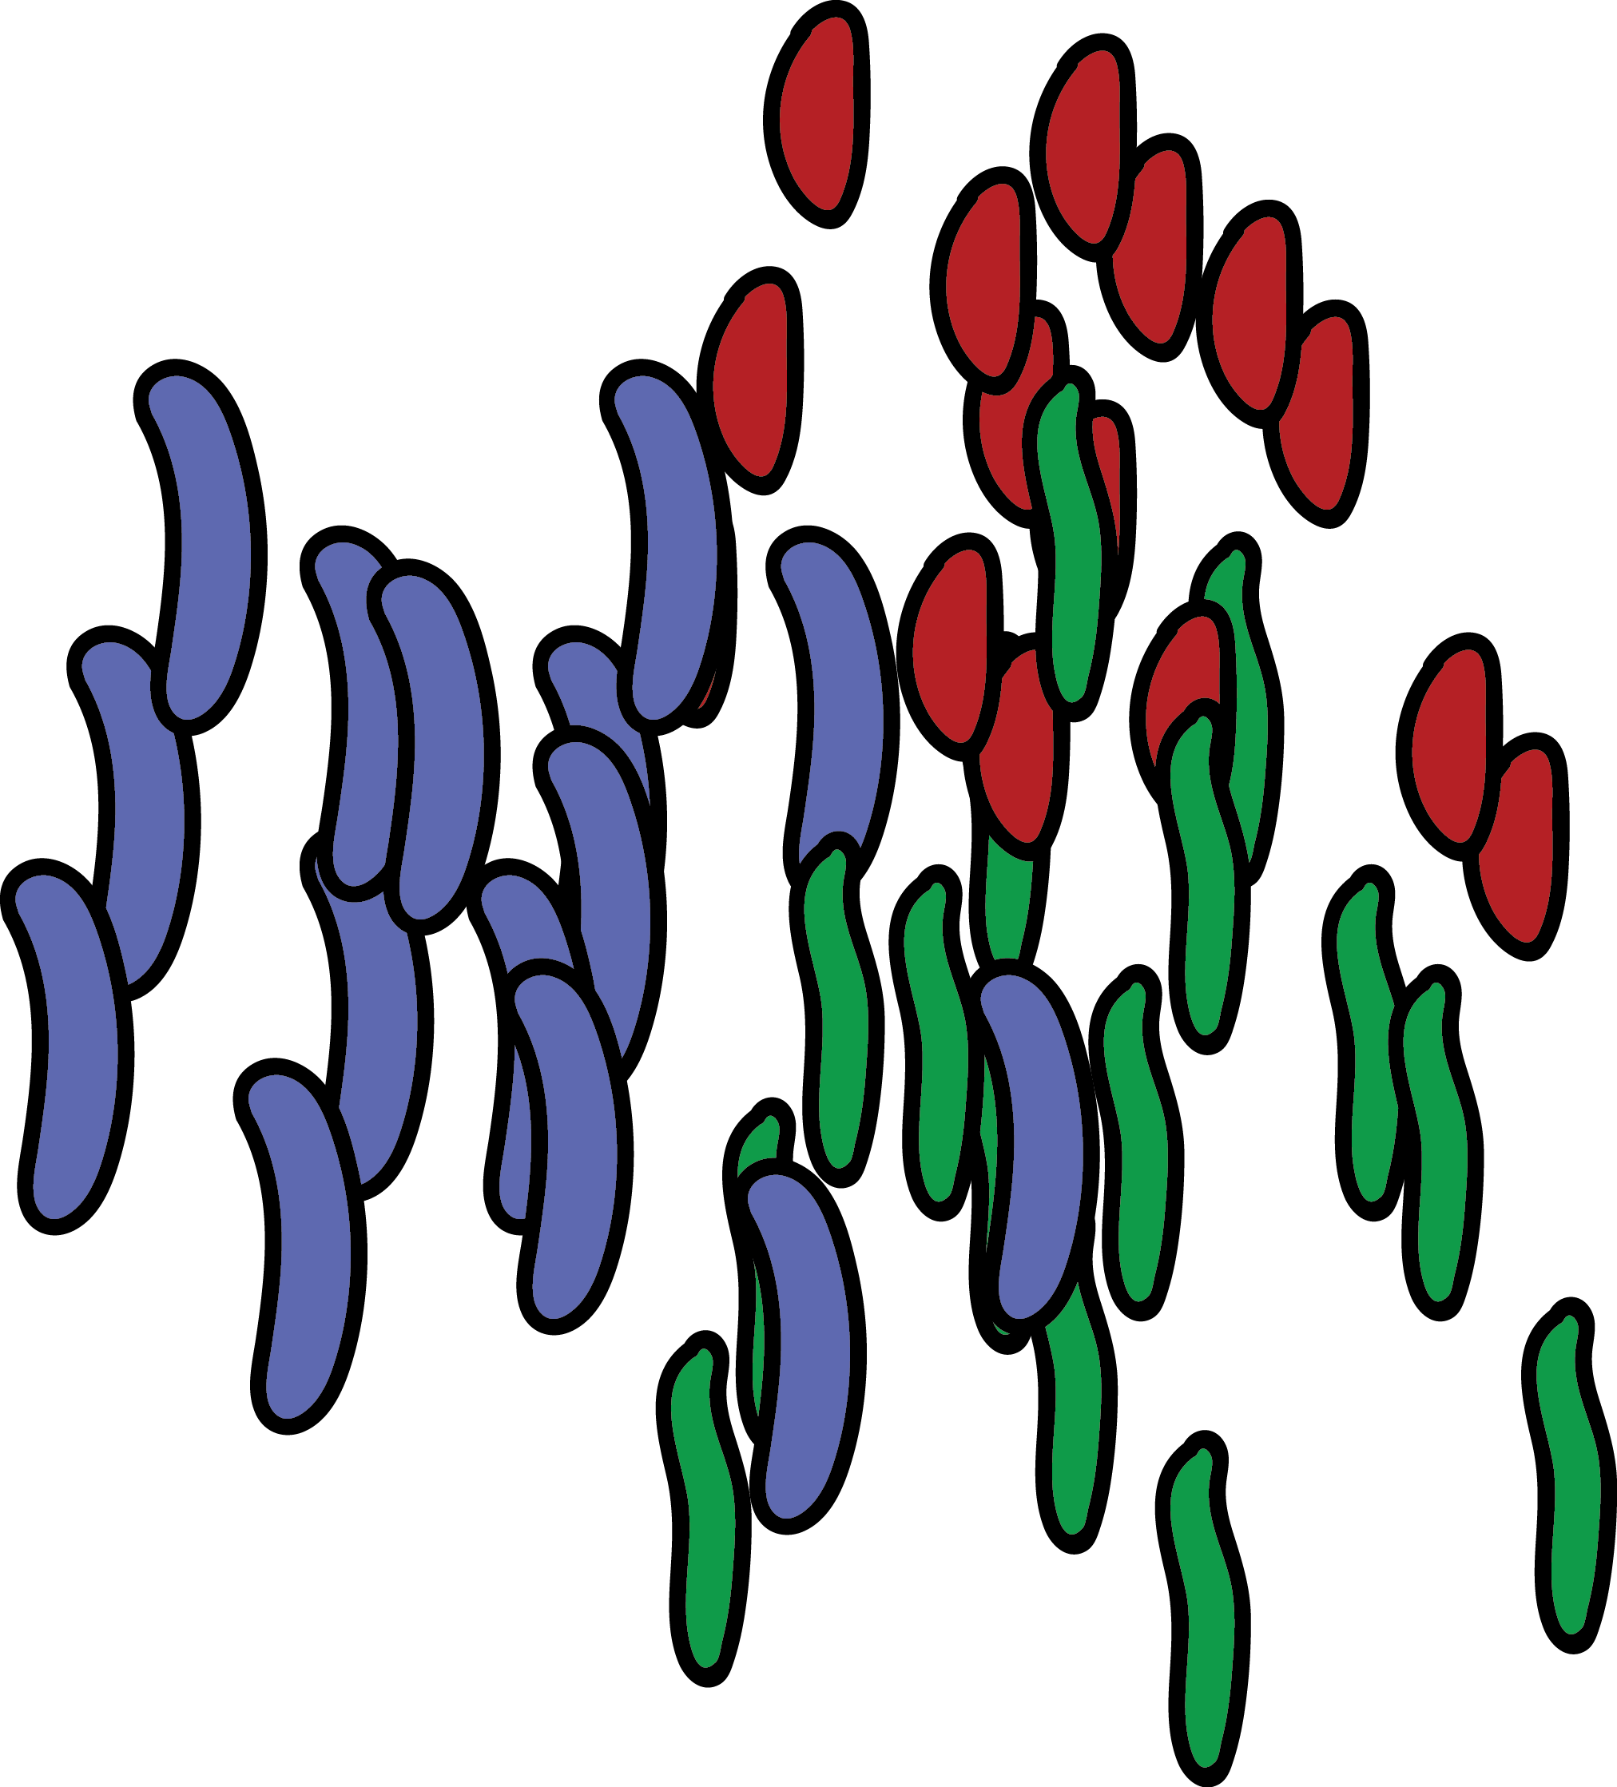
Characterizing metabolic interactions between members of a defined microbiota
Altered Schaedler flora (ASF): 8 bacterial species used to standardize mice since the 1960s
Fewer than a dozen in vitro studies of the ASF to date
Start simple:
pairwise interactions
Germ-free mouse
ASF
+
ASF mouse
Medlock et al. Cell Systems 2018
Background | Aim 1: metabolic interactions | Aim 2: metabolic capabilities | Conclusions
Notes:
Metabolic interactions are some of the most common interspecies interactions within all microbial communities, so methods for inferring mechanisms of metabolic interaction may be broadly useful. To maximize the transference of knowledge from our study to traditional microbiome research, we selected a model mouse microbiota, the altered Shaedler flora, or ASF. This community has been widely used in breeding facilities by major mouse vendors, but little characterization of the community itself has even been done.
So with the goal of inferring metabolic mechanisms that govern interspecies growth interactions, we designed a pairwise co-culture study using 6 of the ASF species that grow in the same media condition. We grew the strains anaerobically, and at the end of the incubation period harvested a cell pellet to quantify the population size for each species using species-specific probe-based qPCR, and the supernatant to identify changes in metabolite concentrations with untargeted metabolomics.

Slide 17
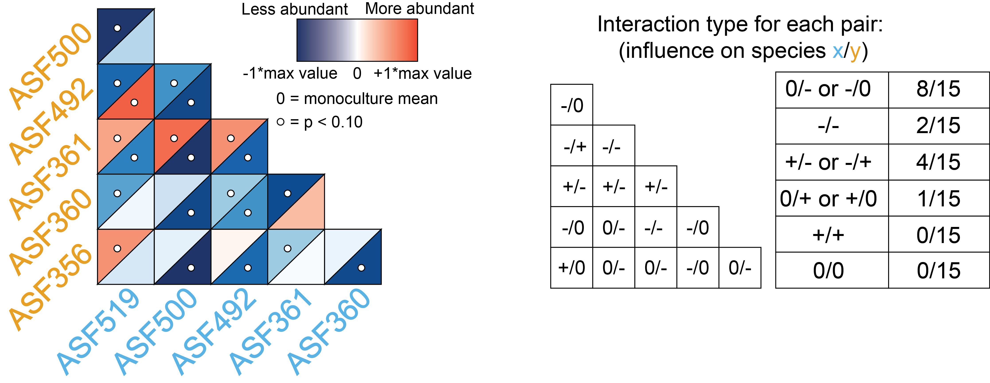
Growth interactions within the ASF
Most co-cultures had a negative effect on growth
Only one co-culture had a net-positive interaction
Medlock et al. Cell Systems 2018
Background | Aim 1: metabolic interactions | Aim 2: metabolic capabilities | Conclusions
Notes:
The population size outcomes are shown in this heatmap, where each cell indicates the abundance of each of the two species in each co-culture; the data are centered so that the monoculture abundance for each species is 0, so red indicates the species was more abundant in the co-culture and blue indicates the species was less abundant than in co-culture. So for example in this co-culture here, there was no impact on the abundance of ASF519, but ASF356 experienced a growth benefit.
Summarizing the results across all 15 co-cultures, we see that the majority of the interactions negatively influence growth relative to monoculture, while only one co-culture had a net positive interaction. So from a resource allocation standpoint, it looks like we may have quite a bit of competition in these co-cultures with limited cooperation. Given these changes in growth in co-culture, we next sought to understand the metabolic mechanisms that might underlie them.

Slide 18
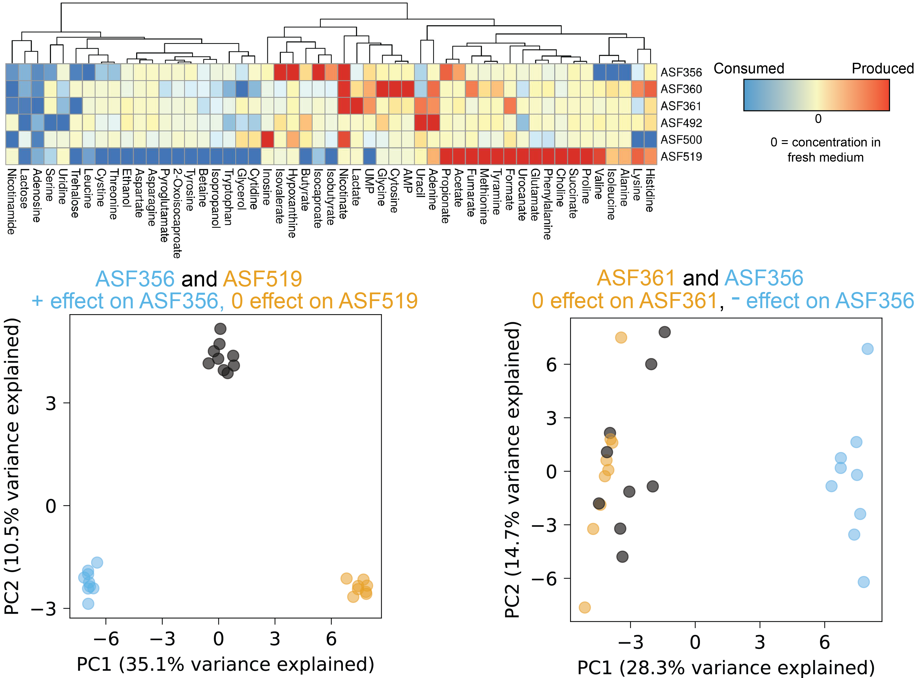
Metabolic profiling of mono- and co-culture supernatant
Metabolite consumption and production in monoculture:
Principal component analysis of mono + co-culture metabolomes:
Co-culture
Co-cultures similar to
one monoculture
Which metabolites drive the growth interaction?
Co-culture vs.
monoculture
Monoculture separation
Medlock et al. Cell Systems 2018
Background | Aim 1: metabolic interactions | Aim 2: metabolic capabilities | Conclusions
Notes:
To do this, we performed hydrogen NMR spectroscopy-based metabolomics on supernatants from all samples in the study. The monoculture metabolomics data allowed us to identify metabolites consumed and produced by each species in the study. When we examine the co-culture metabolomics data alongside the monoculture data, a few striking trends emerge. First, we’ll look at this trend for ASF356 and ASF519, the only pairing that resulted in a net positive effect. When we perform principal component analysis on the metabolomics data from both the monocultures for these species and their co-culture, the first principal component, which describes the largest proportion of variance, separates the two monoculture groups, and the coculture samples lie directly in the middle of this first axis. This implies that the variance captured in the first axis discriminates between each of the monocultures, and the abundances of the metabolites represented in the loadings of the first principal component in coculture are simply a mixture of the two monocultures. In contrast, the second principal component separates the monocultures from the co-cultures, which means that there is variance in the dataset introduced by the co-cultures that can’t be explained by the mixing effect observed in principal component 1.
Given this, we could just look at the loadings of the PCA and say those in PC2 are driving the growth interaction, but we need to control for changes in the population size of each species in this analysis!

Slide 19
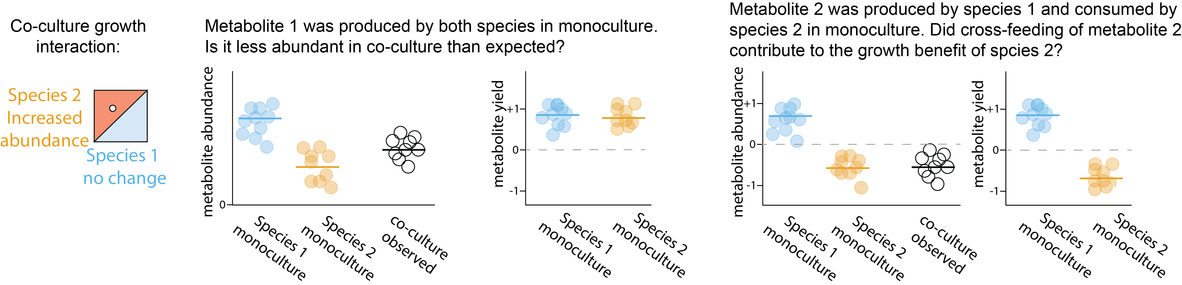
Changes in species abundance confound interpretation of metabolomics data
Given a yield-based expectation:
Did co-culture enhance or decrease yield
of this metabolite?
Did co-culture lead to cross-feeding?
Medlock et al. Cell Systems 2018
Background | Aim 1: metabolic interactions | Aim 2: metabolic capabilities | Conclusions
Notes:
To see this, imagine we have a scenario in which one strain experiences a growth benefit, and another strain has no appreciable change. Both of these strains produced a particular metabolite in monoculture, at the relative amounts shown here, and each had approximately equal yields for this metabolite based on the amount produced per unit of strain biomass. In trying to infer whether the co-culture behavior was as expected for this metabolite, we must ask whether the abundance observed in co-culture matches our expectation. To create this expectation, we decided to assume that behavior in co-culture should be differential if the apparent yield of a metabolite changed in co-culture relative to the monoculture behavior. That is, one of the strains produced a larger or smaller quantity of a metabolite per unit biomass in co-culture than it did in monoculture.
Pull out abundance plot, replace with heatmap version

Slide 20
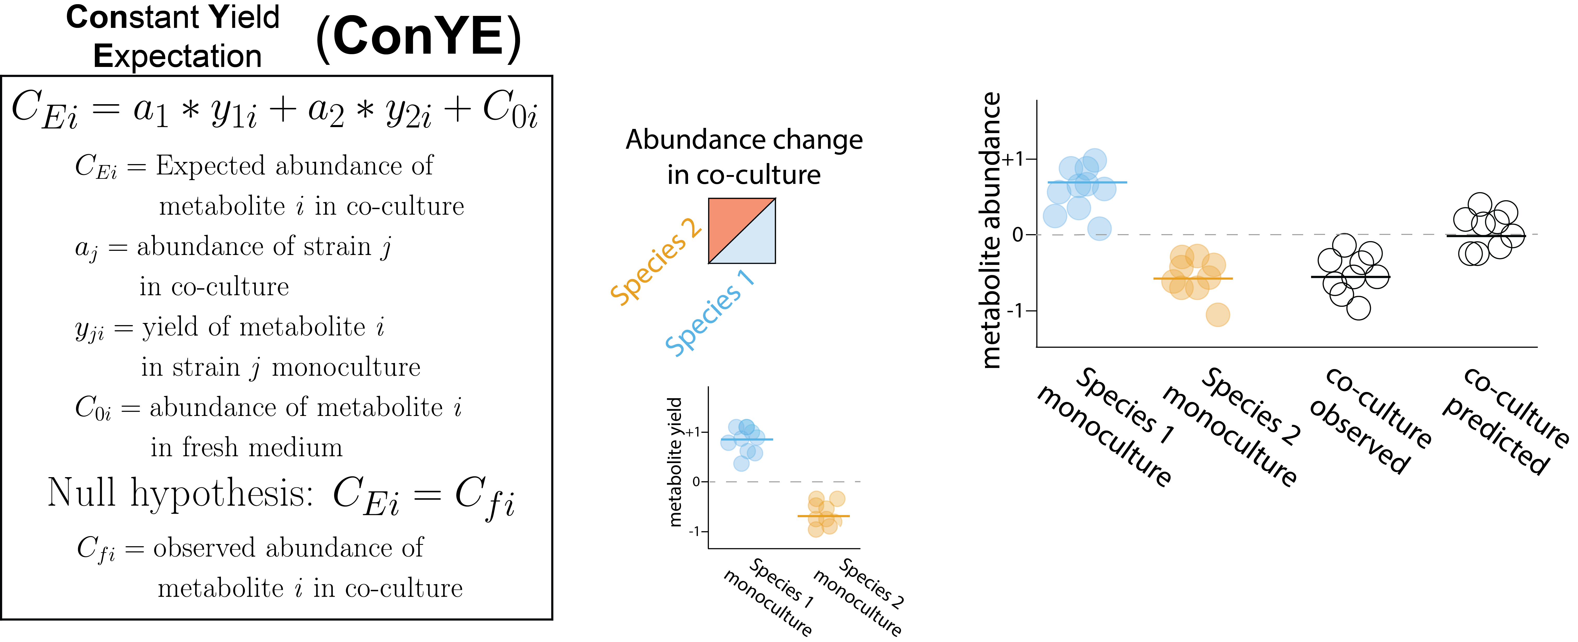
Accounting for species abundance and expected metabolite yield with ConYE
???
Medlock et al. Cell Systems 2018
Background | Aim 1: metabolic interactions | Aim 2: metabolic capabilities | Conclusions
Notes:
We tested this expectation formally by constructing what we have named the constant yield expectation model, or ConYE. In ConYE, we first generate an expected metabolite quantity for each co-culture, by summing the original quantity of the metabolite in the medium with change values derived from the abundance of each strain in co-culture multiplied by the yield of each metabolite for that strain in monoculture. So, given a yield for a metabolite that we calculate by determining the amount of metabolite produced per unit biomass for each species, we sum these quantities to produce our expectation value—that is, the quantity of the metabolite we expect to be present if each strain maintained their metabolic behavior from monoculture. One of these expected values is generated for every co-culture sample for every measured metabolite.
Then, we test the null hypothesis that this simulated quantities for a metabolite in a particular co-culture are equal to the actual observed quantity using standard univariate testing with multiple testing correction across all conditions. If we reject the null, this implies that differential behavior occurred for this co-culture and metabolite.
Shown to the right are examples of ConYE results for two metabolites across all co-culture conditions. In each plot, the lower left triangle in each cell is the observed abundance in co-culture, whereas the upper right is the expectation value calculated in ConYE. Here, red means the metabolite was produced, blue means consumed, and the asterisk indicates that the null hypothesis was rejected. So for lactose, which was consumed by all strains, we can interpret the result for 356 and 519 as lower consumption than expected, since the observed abundance of the metabolite is higher than the predicted abundance. This occurs for many of the co-cultures for lactose, suggesting either more efficient utilization of lactose in co-culture, or that other metabolites were utilized to contribute to biomass production.
An alternative case is that of Valine, which was produced by some species and consumed by others. Interestingly, we see that valine is generally as abundant as expected—implying that strains were able to maintain their consumption and production behavior in co-culture. We will revisit how this kind of result can aid our interpretation of potential mechanisms of interaction, as well as the caveats associated with it.

Slide 21
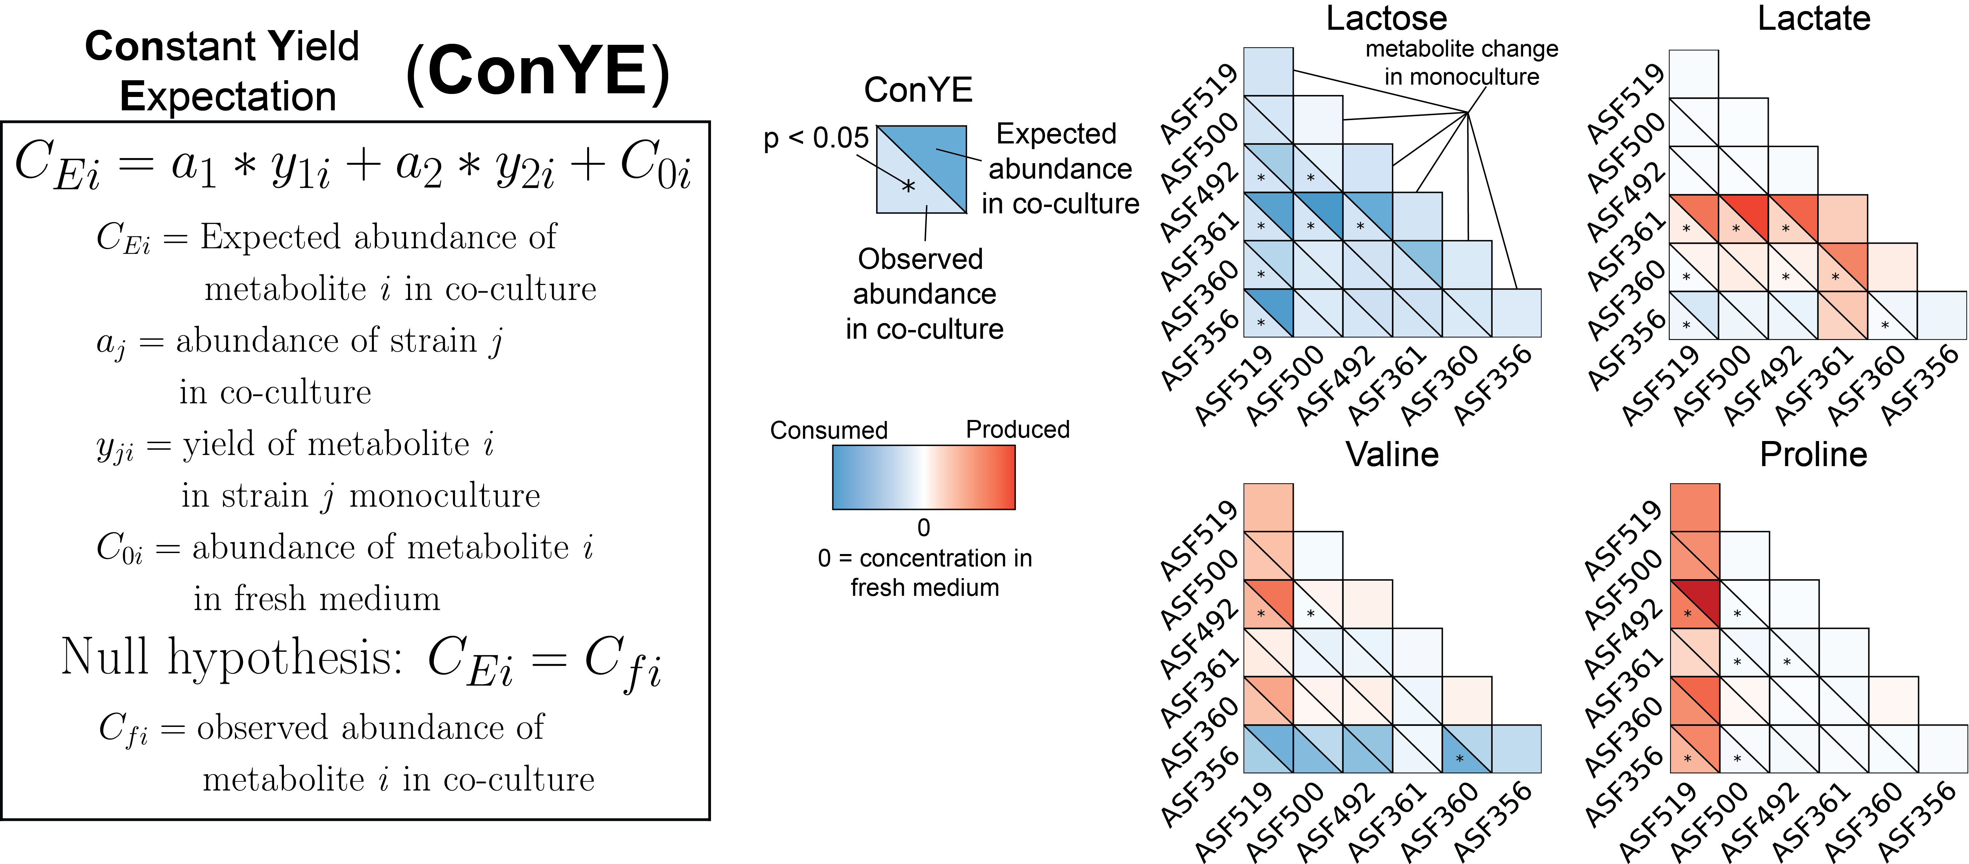
Accounting for species abundance and expected metabolite yield with ConYE
Less consumption than expected suggests increased biomass yield or use of alternative energy sources
Medlock et al. Cell Systems 2018
Background | Aim 1: metabolic interactions | Aim 2: metabolic capabilities | Conclusions
Notes:
We tested this expectation formally by constructing what we have named the constant yield expectation model, or ConYE. In ConYE, we first generate an expected metabolite quantity for each co-culture, by summing the original quantity of the metabolite in the medium with change values derived from the abundance of each strain in co-culture multiplied by the yield of each metabolite for that strain in monoculture. So, given a yield for a metabolite that we calculate by determining the amount of metabolite produced per unit biomass for each species, we sum these quantities to produce our expectation value—that is, the quantity of the metabolite we expect to be present if each strain maintained their metabolic behavior from monoculture. One of these expected values is generated for every co-culture sample for every measured metabolite.
Then, we test the null hypothesis that this simulated quantities for a metabolite in a particular co-culture are equal to the actual observed quantity using standard univariate testing with multiple testing correction across all conditions. If we reject the null, this implies that differential behavior occurred for this co-culture and metabolite.
Shown to the right are examples of ConYE results for two metabolites across all co-culture conditions. In each plot, the lower left triangle in each cell is the observed abundance in co-culture, whereas the upper right is the expectation value calculated in ConYE. Here, red means the metabolite was produced, blue means consumed, and the asterisk indicates that the null hypothesis was rejected. So for lactose, which was consumed by all strains, we can interpret the result for 356 and 519 as lower consumption than expected, since the observed abundance of the metabolite is higher than the predicted abundance. This occurs for many of the co-cultures for lactose, suggesting either more efficient utilization of lactose in co-culture, or that other metabolites were utilized to contribute to biomass production.
An alternative case is that of Valine, which was produced by some species and consumed by others. Interestingly, we see that valine is generally as abundant as expected—implying that strains were able to maintain their consumption and production behavior in co-culture. We will revisit how this kind of result can aid our interpretation of potential mechanisms of interaction, as well as the caveats associated with it.

Slide 22
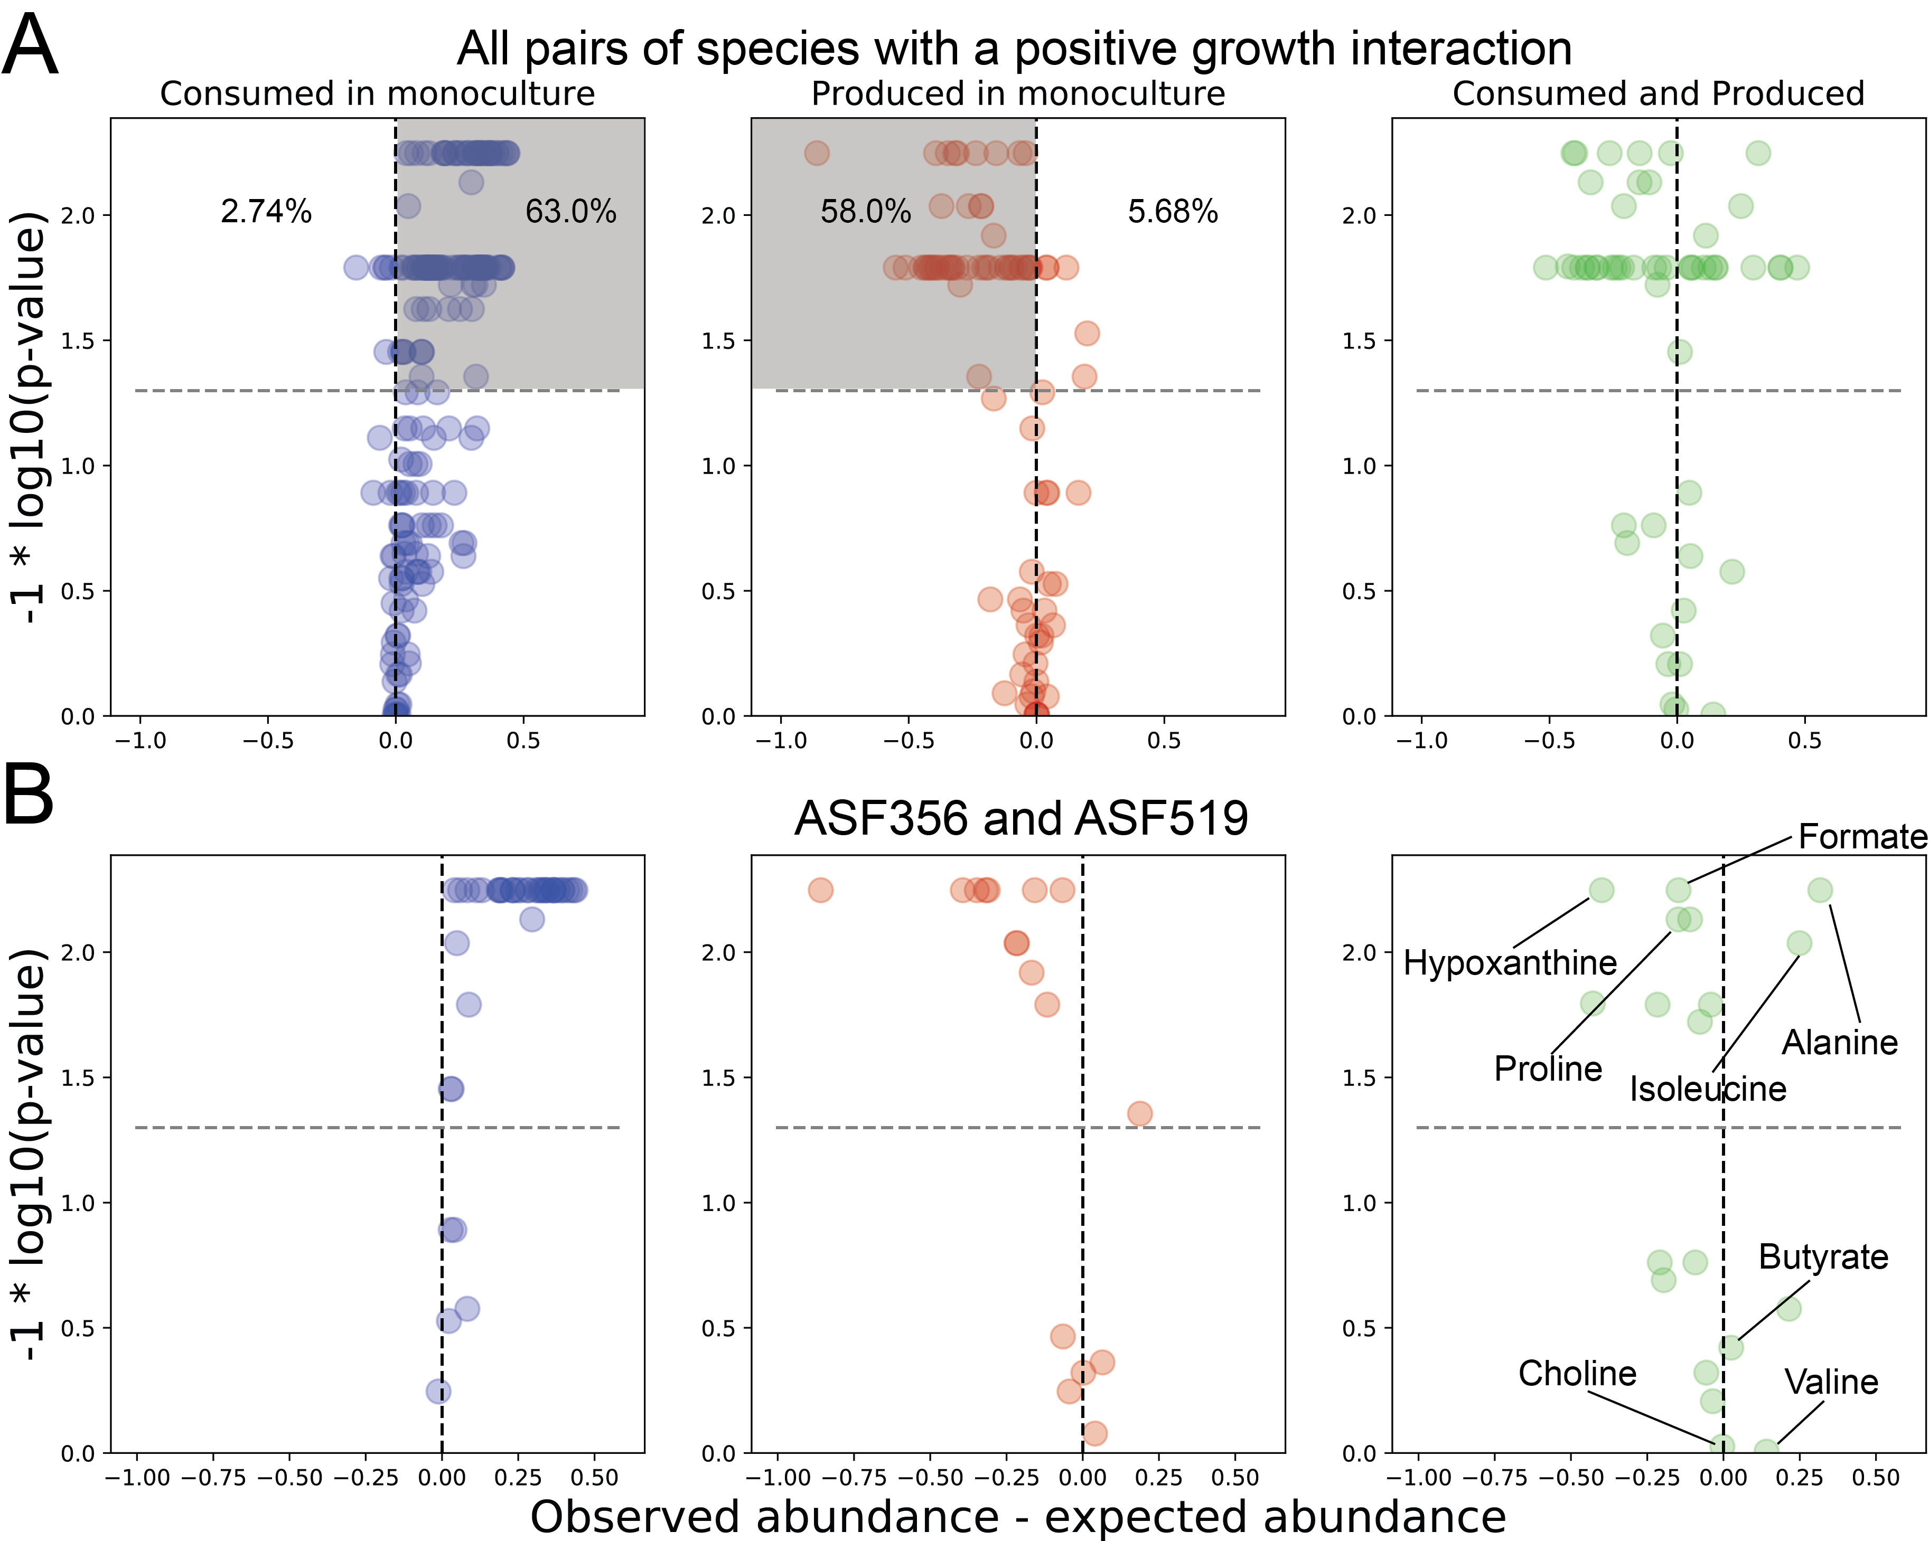
Resource utilization in co-cultures with positive growth interactions
Decreasing
p-value
Less abundant
than expected
More abundant
than expected
Less abundant
than expected
More abundant
than expected
Species generate biomass more efficiently in co-culture
Medlock et al. Cell Systems 2018
Background | Aim 1: metabolic interactions | Aim 2: metabolic capabilities | Conclusions
Notes:
In trying to understand how co-culture growth behavior might be explained by our metabolomics data, we examined the ConYE results for all metabolites for all co-cultures in which at least one species experienced a growth benefit. We found that these positively interacting species appeared to use their resources more efficiently in co-culture than in monoculture. We can present this data on a volcano plot, where the x axis describes the magnitude of the difference between the observed and expected values, so metabolites to the right were more abundant in co-culture and metabolites to the left were less abundant than expected in co-culture. The y axis describes the p-value for the comparison, so as we go up on this axis, the p value decreases, and any point above this dashed grey line has a p value lower than our significance threshold. For metabolites that either of the species in a co-culture consumed when grown in monoculture, 63% were more abundant than expected based on ConYE, implying that more biomass was produced per unit consumed of each of these metabolites. This is in sharp contrast to the opposite scenario, where only 2.7 percent of consumed metabolites were less abundant than expected.
In support of our interpretation of increased efficiency in co-culture, metabolites that were produced in monoculture tended to be less abundant than expected, implying that a smaller amount of product secretion was required per unit biomass in co-culture.
There are many reasons that these trends could emerge, but their existence suggest that there is substantial metabolic interaction amongst these species.
Cases where metabolites that were consumed by one species in monoculture and produced by another species in monoculture are more difficult to interpret.

Slide 23
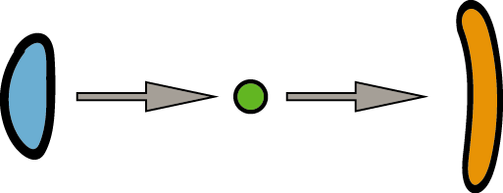
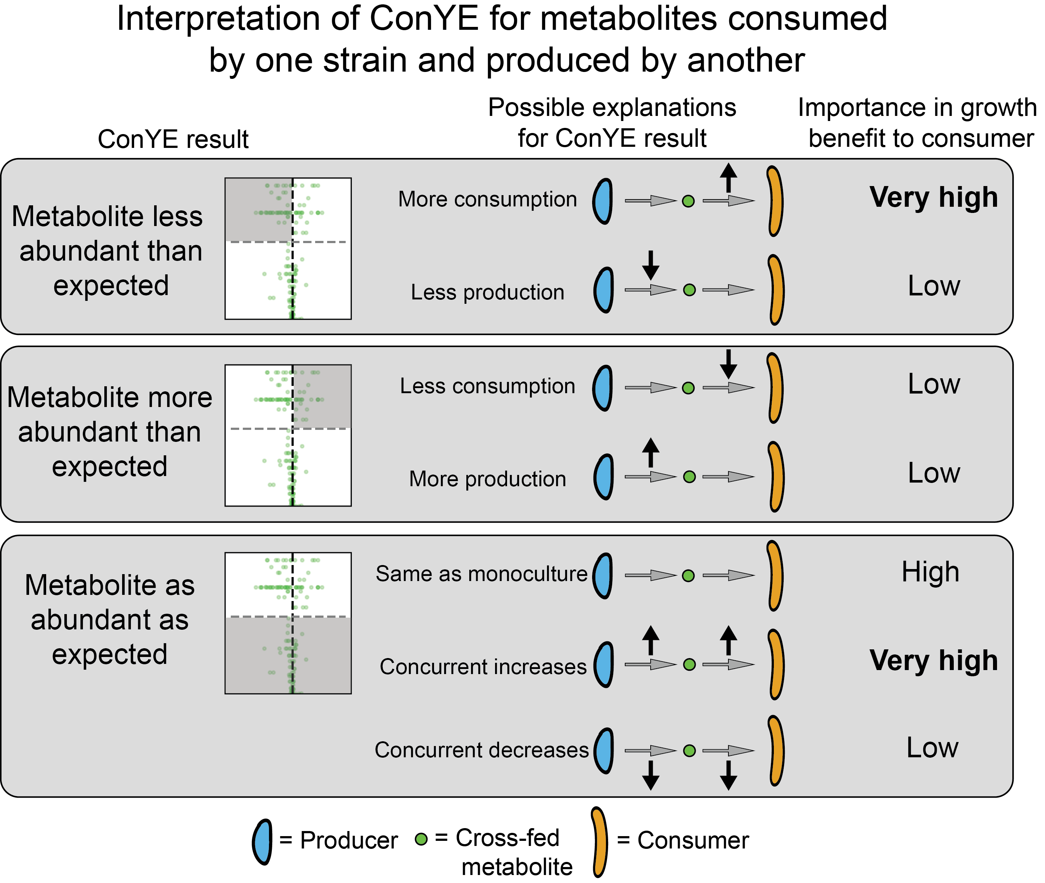
Evidence for cross-feeding from ConYE
Decreasing
p-value
Less abundant
than expected
More abundant
than expected
Medlock et al. Cell Systems 2018
Background | Aim 1: metabolic interactions | Aim 2: metabolic capabilities | Conclusions

Slide 24
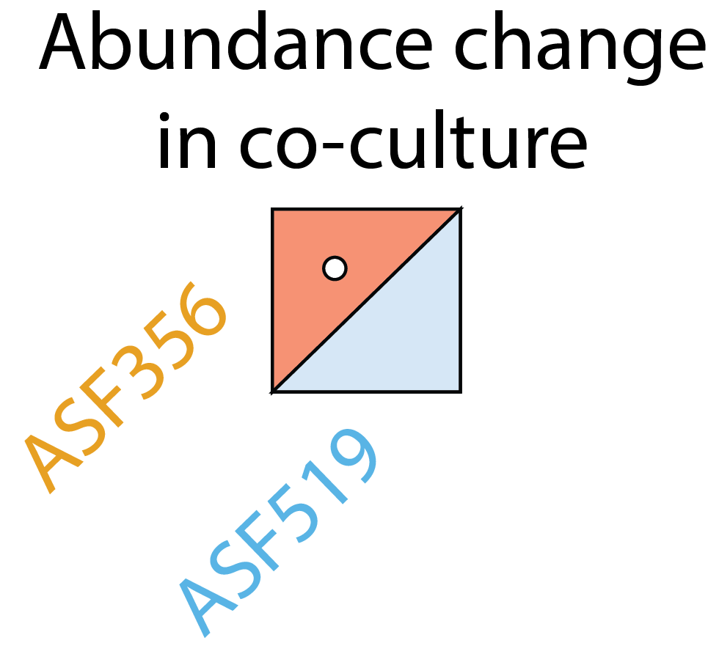
Putative cross-fed metabolites that improved growth of ASF356 co-cultured with ASF519
(ASF519)
(ASF356)
Decreasing
p-value
Less abundant
than expected
More abundant
than expected
Medlock et al. Cell Systems 2018
Background | Aim 1: metabolic interactions | Aim 2: metabolic capabilities | Conclusions

Slide 25
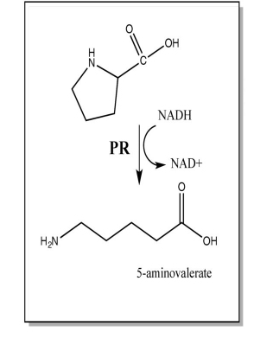
Putative cross-fed metabolites that improved growth of ASF356 co-cultured with ASF519
ASF356 belongs to the genus Clostridium, which are known to be highly proteolytic
Stickland fermentation: identified in 1934 in Clostridium sporogenes
Hypothesis: Proline and valine produced by ASF519 are used by ASF356 in Stickland fermentation
Decreasing
p-value
Proline reduction,
paired with oxidation of
alanine, isoleucine, or valine
Less abundant
than expected
More abundant
than expected
Medlock et al. Cell Systems 2018
Background | Aim 1: metabolic interactions | Aim 2: metabolic capabilities | Conclusions

Slide 26
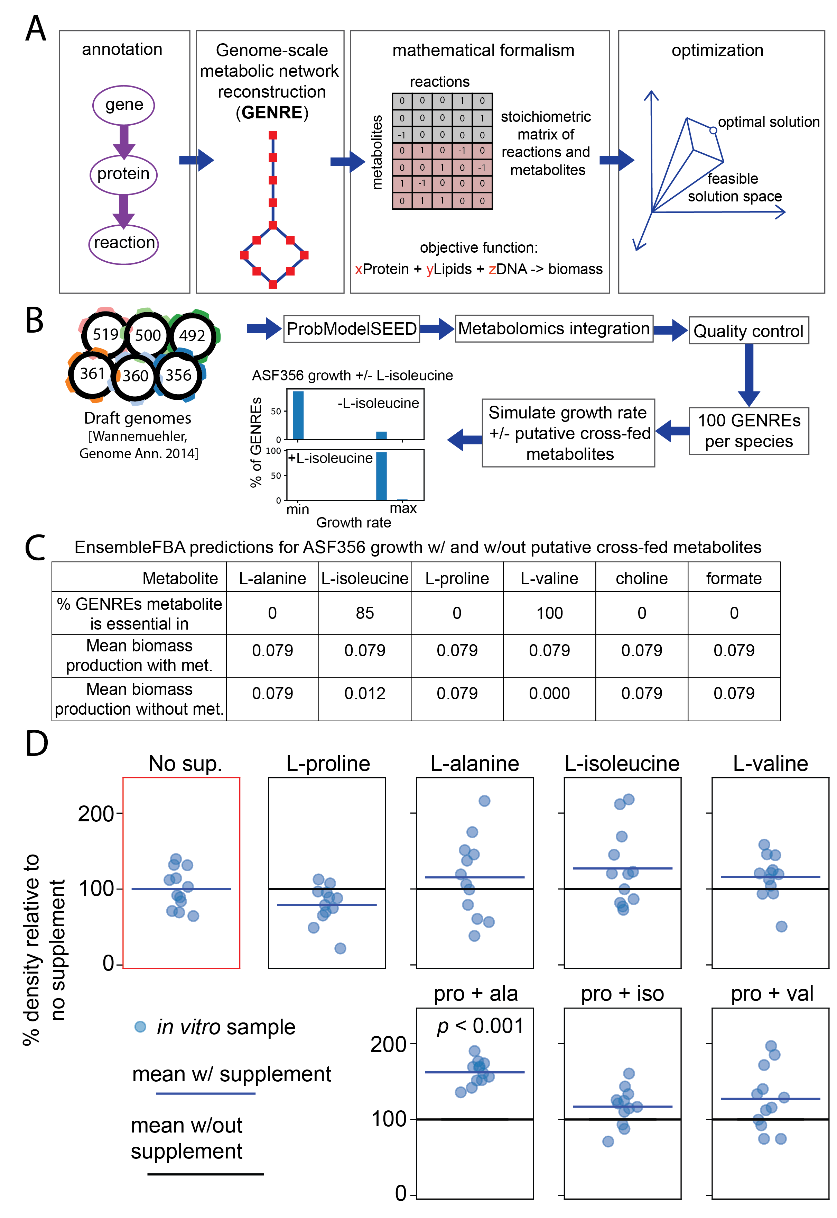
Experimental support for Stickland fermentation of proline by ASF356
Increased growth from supplementation of a Stickland pair, but not individual metabolites, suggests Stickland fermentation facilitates growth of ASF356
Medlock et al. Cell Systems 2018
Background | Aim 1: metabolic interactions | Aim 2: metabolic capabilities | Conclusions

Slide 27
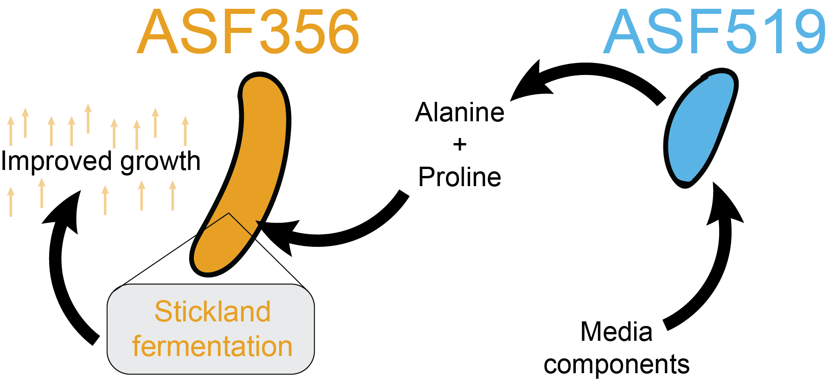
Aim 1 Conclusions
Profiled growth interactions within a defined murine microbiota.
Developed ConYE to account for changes in growth to identify specific metabolites that might govern growth interactions.
Used ConYE to identify a putative cross-feeding interaction powered by a previously unidentified metabolic capability in one of the ASF species.
Medlock et al. Cell Systems 2018
Background | Aim 1: metabolic interactions | Aim 2: metabolic capabilities | Conclusions
Notes:
Together, these points emphasize how the framework presented in Aim 1 advance our understanding of community function of the ASF through new data and insights, specifically guiding targeted hypothesis testing to discover a new biochemical function underlying a growth interaction.
A high throughput screening tool to generate mechanistic hypotheses that can be followed up on using more targeted experiments.

Slide 28
Dissertation Aims
Aim 1:
inferring metabolic interactions
between gut microbes
Aim 2:
Prioritize metabolic characterization of microbes

Slide 29
The problem: lack of functional characterization for gut microbes
>10 million unique genes
Only ~20-40% of these genes can be assigned functions at any level
Background | Aim 1: metabolic interactions | Aim 2: metabolic capabilities | Conclusions

Slide 30
Systems biology: a framework for representing and modeling biology
Enables:
drug target identification
growth simulation across varying environments
Quality of models depends entirely on quality of annotation
Background | Aim 1: metabolic interactions | Aim 2: metabolic capabilities | Conclusions
Notes:
These models enable simulations to identify drug targets or test fro growth across different conditions. But, ...

Slide 31
But gut microbes aren’t well characterized... Why would we use these models?
A model represents a hypothesis about how an organism functions
If an organism carries out a function, but the model has too many gaps to recapitulate that function, we can propose functions that might fill those gaps.
Often, there are multiple ways to fill those gaps, leading to multiple models, or multiple hypotheses
Background | Aim 1: metabolic interactions | Aim 2: metabolic capabilities | Conclusions

Slide 33

Accounting for multiple explanations improves decision-making
Hypothesis 1: Blue driver is late for work
Hypothesis 2: Blue driver is suffering from road rage
Experiment to resolve our uncertainty: Pull over and see if they pass
If pass: Hypothesis 1
No Pass: Hypothesis 2, do not engage!
https://www.motoringresearch.com/car-news/tailgating-kills-seriously-injures-100-people-year/

Slide 34
Little figure about about gapfilling. When we scale this up to real networks for bacteria, we can generate thousands of equally likely network structures

Slide 35
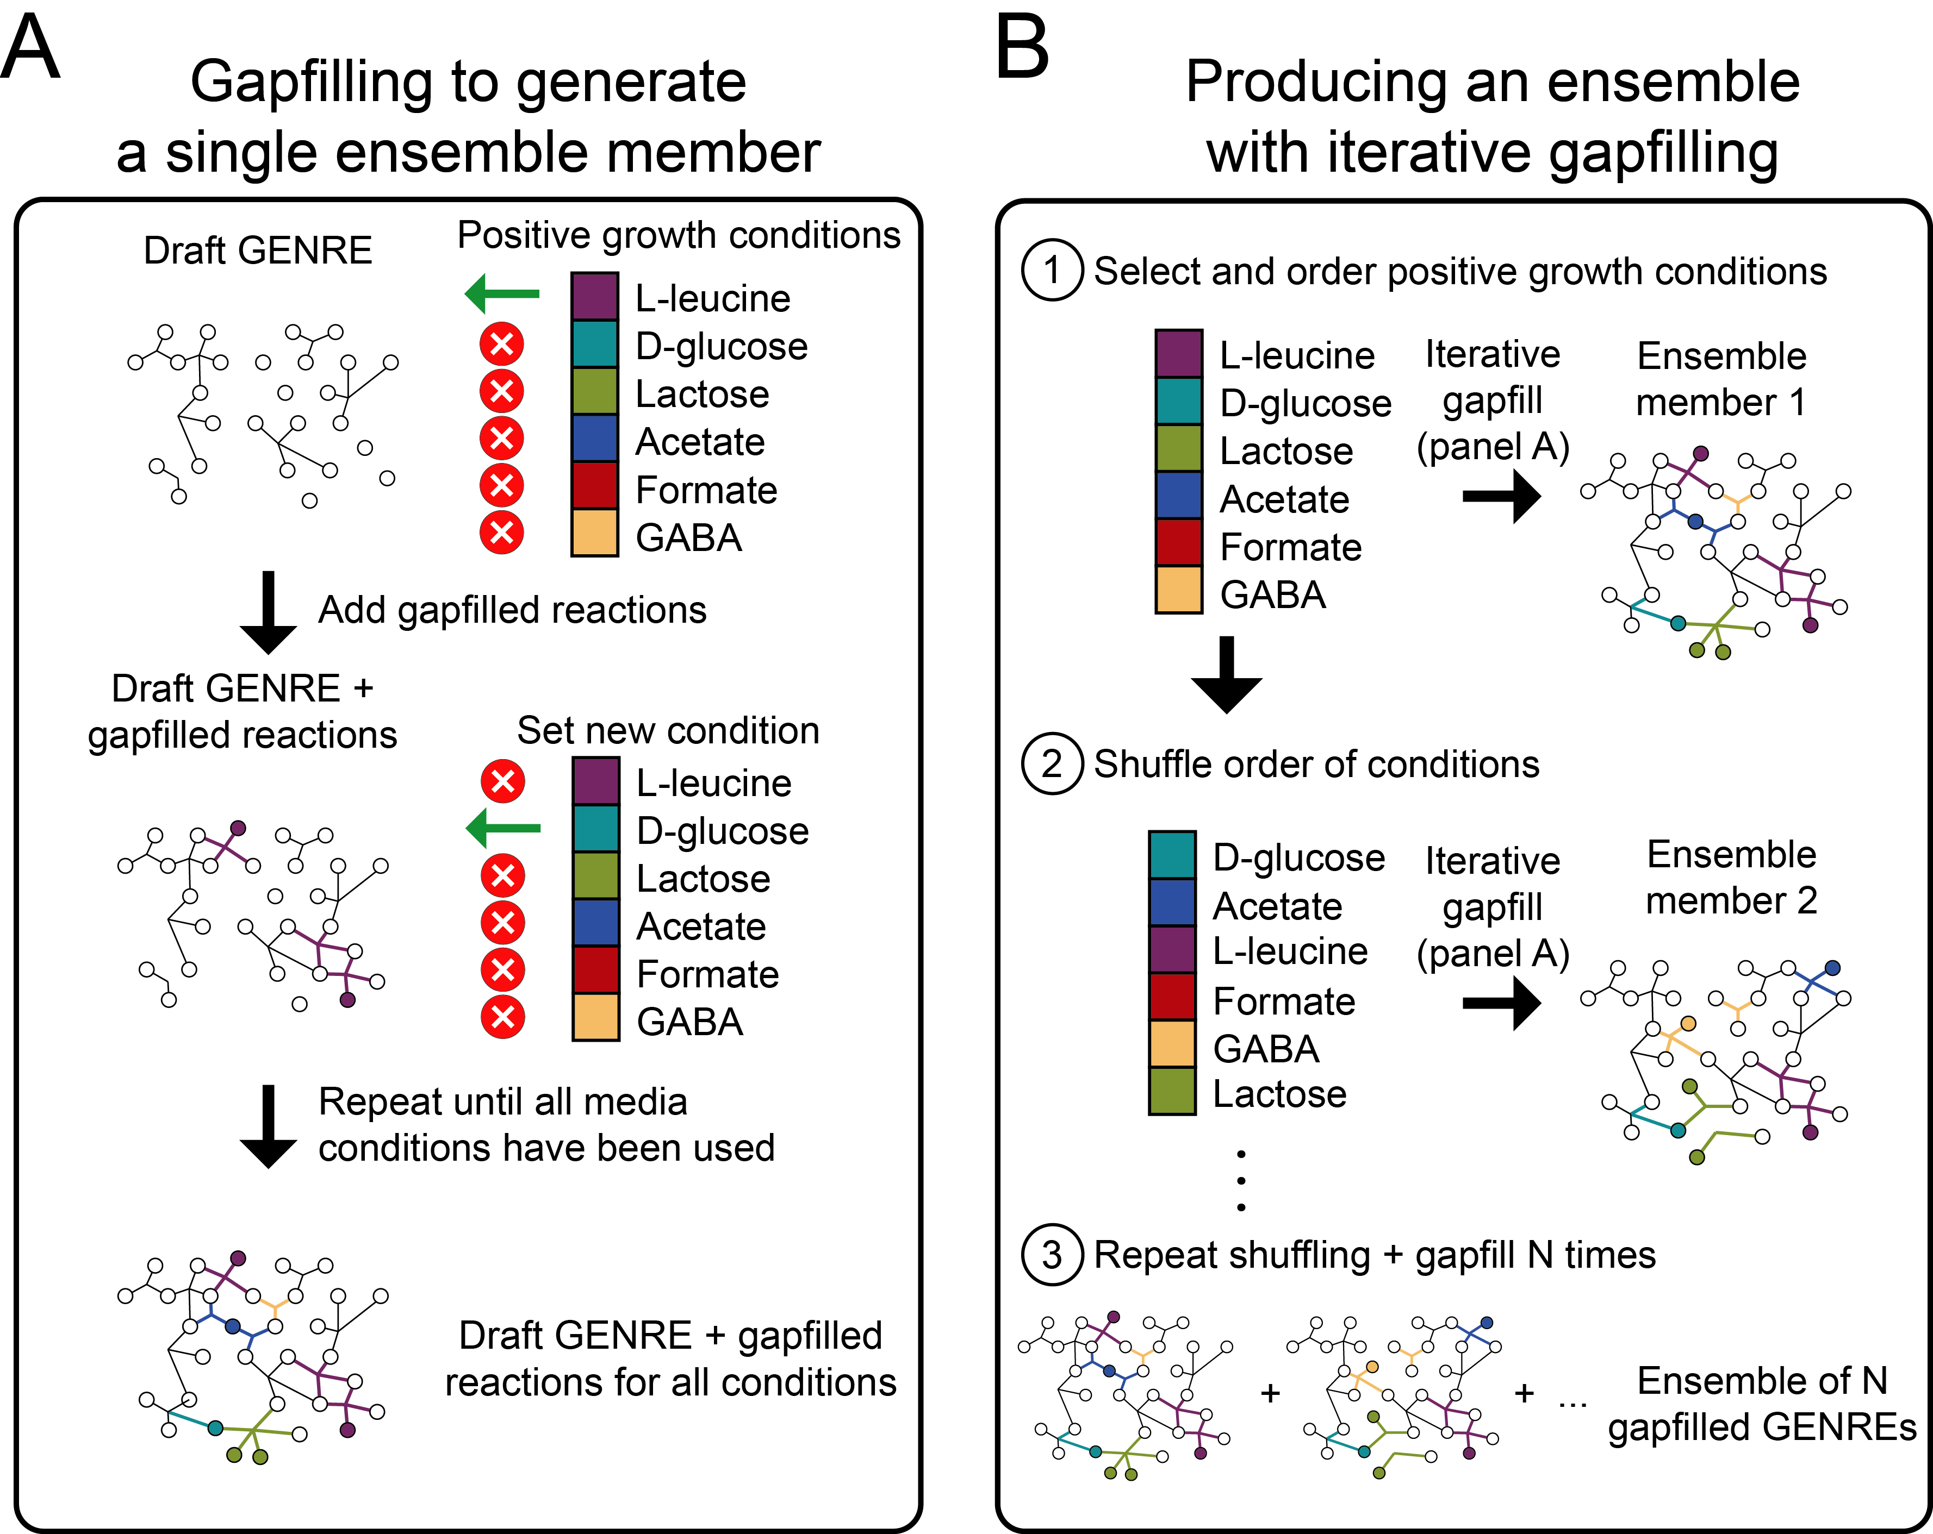
Multiple explanations in metabolic modeling: Ensemble modeling
Background | Aim 1: metabolic interactions | Aim 2: metabolic capabilities | Conclusions

Slide 36
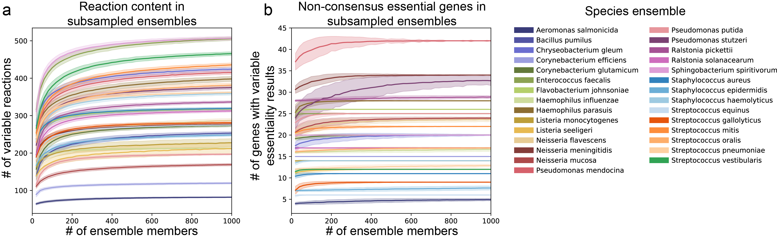
Gapfilling data: Plata et al., Nature 2015
Background | Aim 1: metabolic interactions | Aim 2: metabolic capabilities | Conclusions

Slide 37
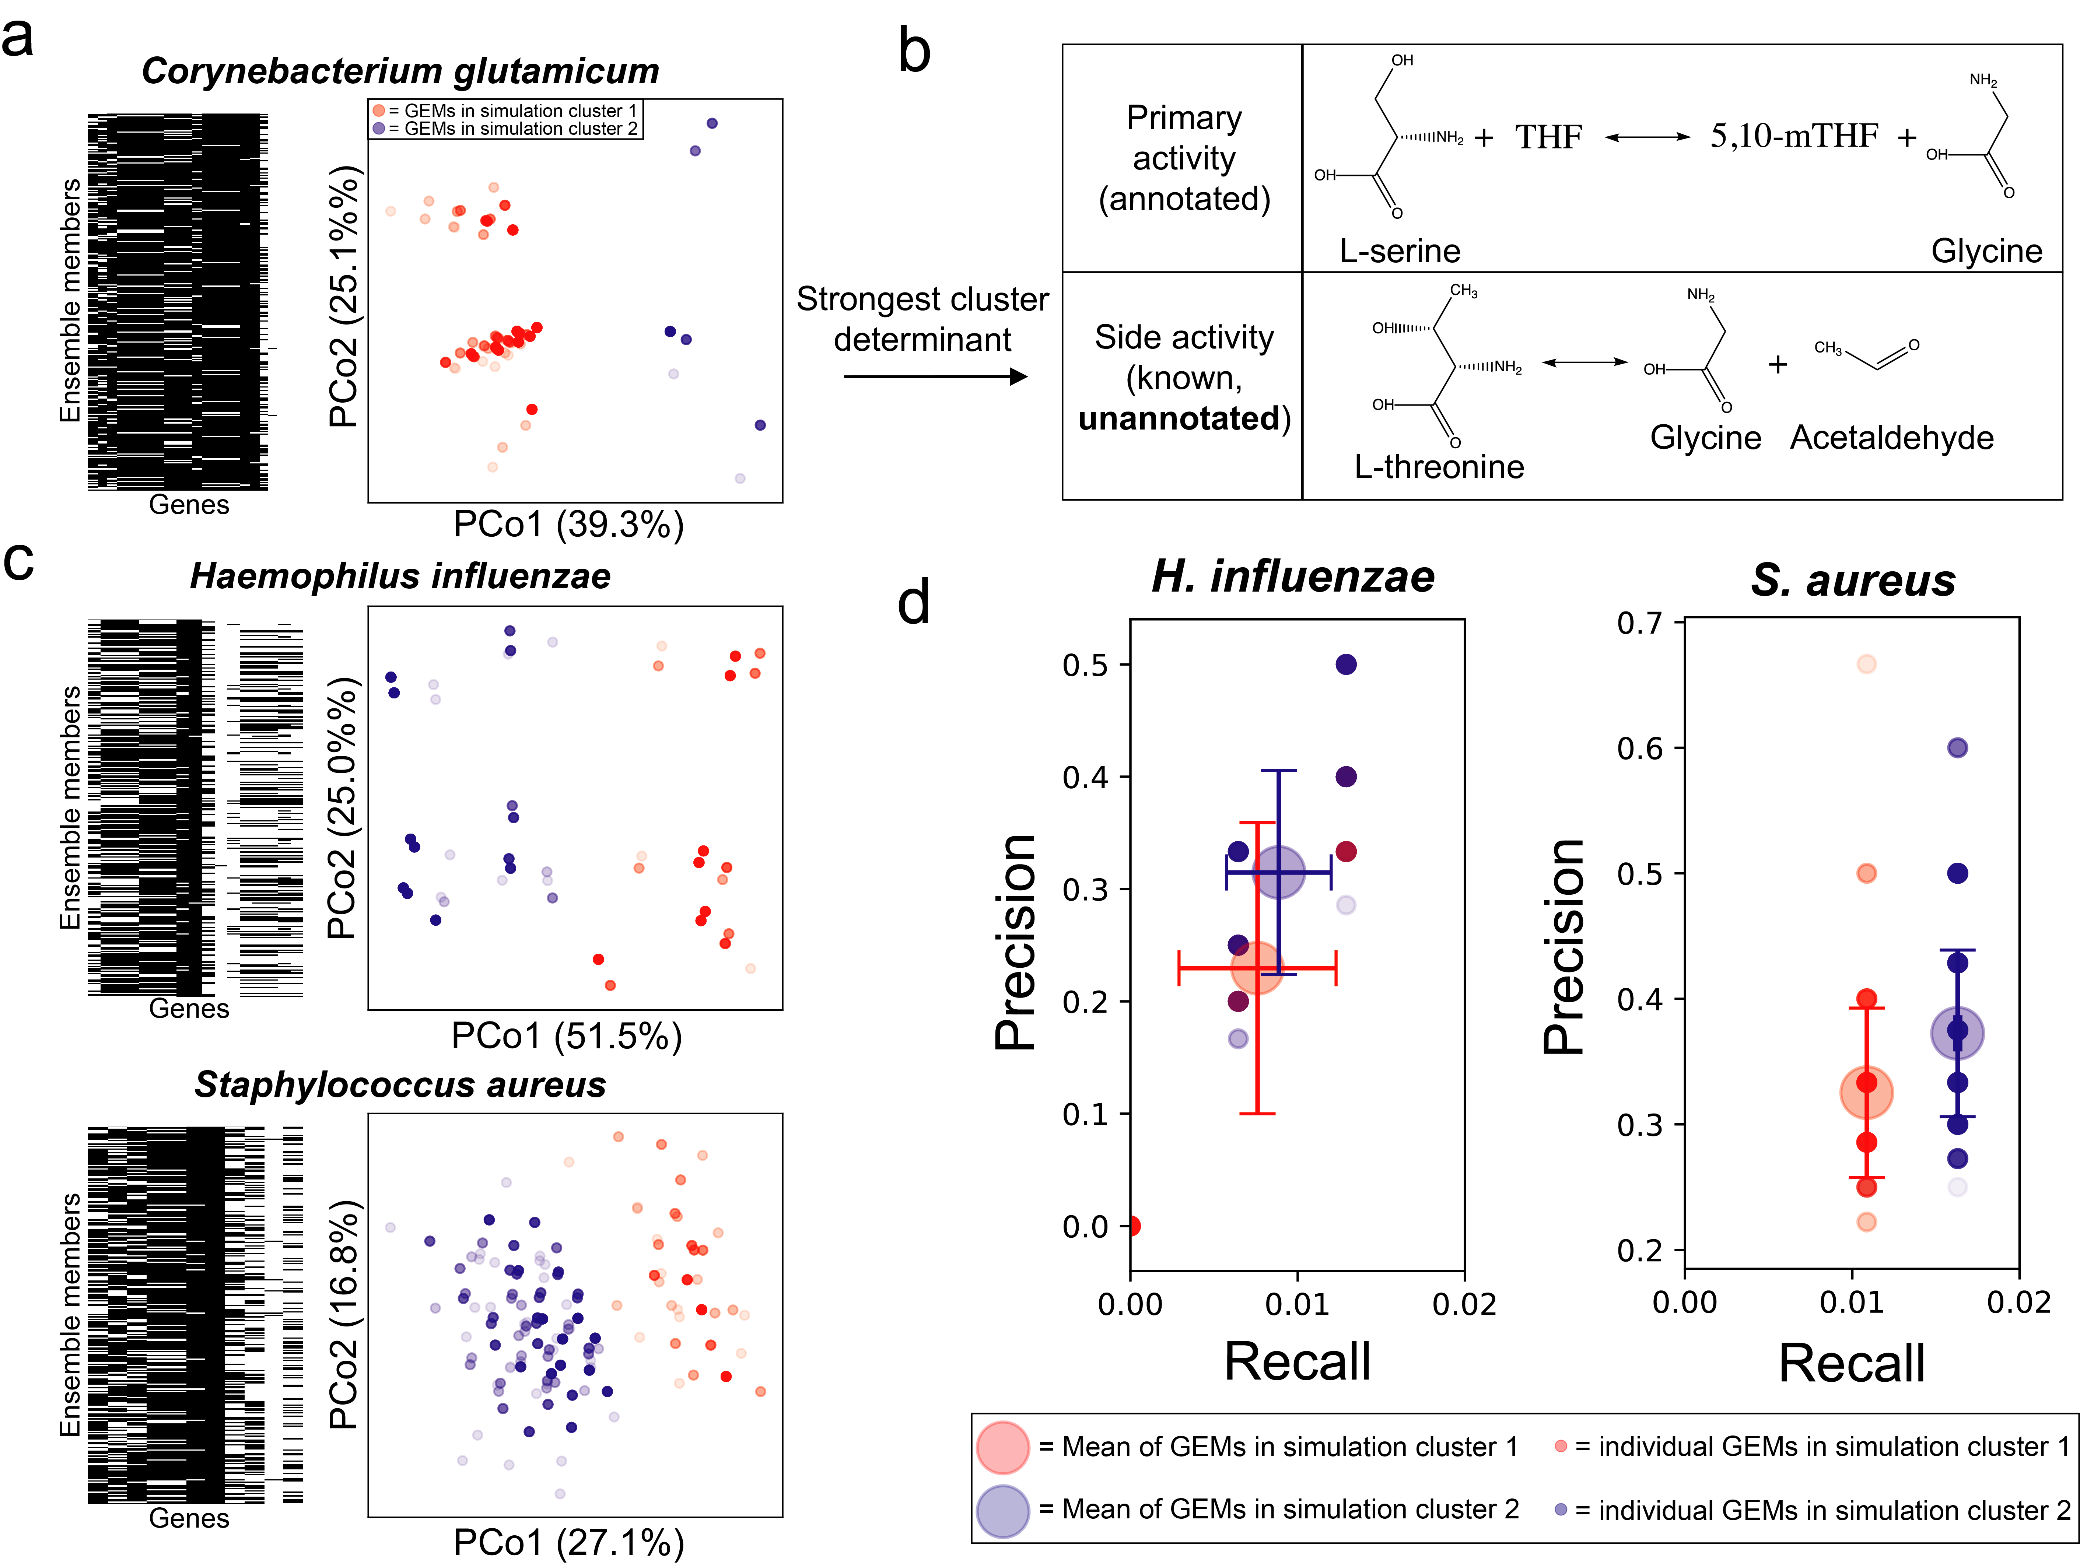
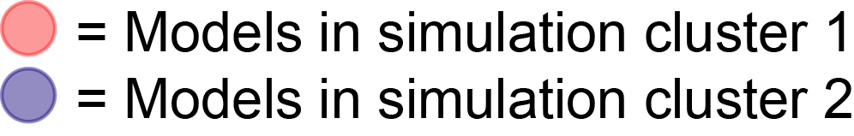
Variation in essential genes across an ensemble
Apply unsupervised machine learning (k-means) to group models by similarity in gene essentiality predictions
Background | Aim 1: metabolic interactions | Aim 2: metabolic capabilities | Conclusions

Slide 38
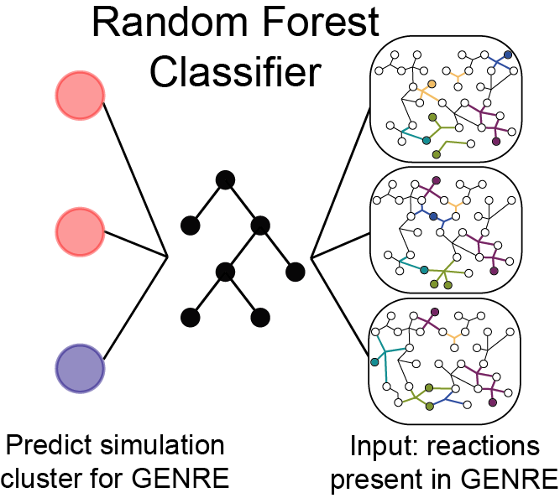
Combining ensembles and machine learning to guide model curation
Background | Aim 1: metabolic interactions | Aim 2: metabolic capabilities | Conclusions

Slide 40
Putting it all together: a guidance system for functional characterization
Efficiency is critical: 10,000s of species of gut microbes
This is the first automated system for guiding curation
Future: need more data to apply to gut microbes
Background | Aim 1: metabolic interactions | Aim 2: metabolic capabilities | Conclusions

Slide 41
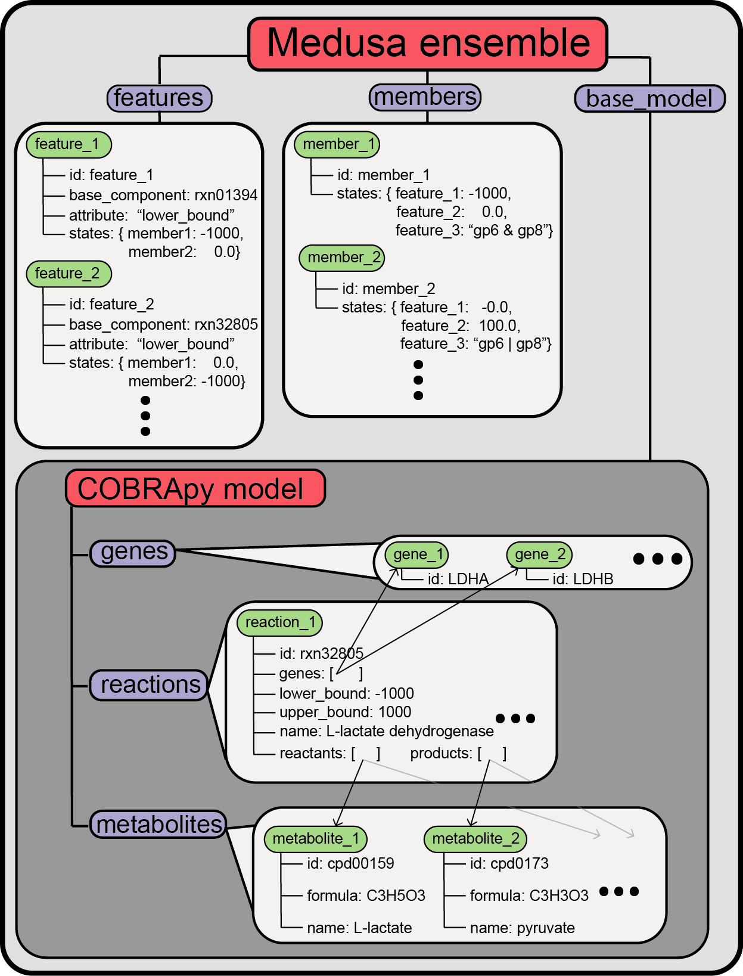
Making ensemble analysis possible
Created Medusa
Open-source python package that builds on community efforts from COBRApy
Background | Aim 1: metabolic interactions | Aim 2: metabolic capabilities | Conclusions

Slide 42
Documentation example
Created Medusa
Background | Aim 1: metabolic interactions | Aim 2: metabolic capabilities | Conclusions

Slide 43
Dissertation Aims
Aim 1:
inferring metabolic interactions
between gut microbes
Aim 2:
Prioritize metabolic characterization of microbes

Slide 44
High levels conclusions from all the work in dissertation

Slide 45
Publications resulting from this work
Aim 1:
Medlock GL, Carey MA, McDuffie DG, Mundy MB, Giallourou N, Swann JR, Kolling GL, Papin JA. “Inferring Metabolic Mechanisms of Interaction Within a Defined Gut Microbiota”. Cell Systems 2018;7:245-257.
Cell Systems most-read article, Sep-Oct 2018
UVA Health System press release
Nature Methods Research Highlight (November 2018)
Highlighted in Nature Methods “Methods to Watch” on Microbial Interactions (December 2018)
Aim 2:
Medlock GL, Papin JA. “Guiding the refinement of biochemical knowledgebases with ensembles of metabolic networks and semi-supervised learning”. bioRxiv, 2018. Under review at PNAS
Medlock GL, Papin JA. Building and analyzing ensembles of genome-scale metabolic network reconstructions using Medusa. In prep.

Slide 46
Collaborative publications
Aim 1:
Medlock GL, Carey MA, McDuffie DG, Mundy MB, Giallourou N, Swann JR, Kolling GL, Papin JA. “Inferring Metabolic Mechanisms of Interaction Within a Defined Gut Microbiota”. Cell Systems 2018;7:245-257.
Cell Systems most-read article, Sep-Oct 2018
UVA Health System press release
Nature Methods Research Highlight (November 2018)
Highlighted in Nature Methods “Methods to Watch” on Microbial Interactions (December 2018)
Aim 2:
Medlock GL, Papin JA. “Guiding the refinement of biochemical knowledgebases with ensembles of metabolic networks and semi-supervised learning”. bioRxiv, 2018. Under review at PNAS
Medlock GL, Papin JA. Building and analyzing ensembles of genome-scale metabolic network reconstructions using Medusa. In prep.

Slide 47
Acknowledgements

Slide 48
Acknowledgements extended

Slide 49
Questions
Aim 1:
inferring metabolic interactions
between gut microbes
Aim 2:
Prioritize metabolic characterization of microbes

Slide 51
Background | Aim 1: metabolic interactions | Aim 2: metabolic capabilities | Conclusions

Slide 52
Background | Aim 1: metabolic interactions | Aim 2: metabolic capabilities | Conclusions

Slide 53

Acknowledgements
UVA
Jason Papin, PhD
Glynis Kolling, PhD
Matthew Jenior, PhD
Maureen Carey, PhD
Anna Blazier
Kristopher Rawls
Bonnie Dougherty
Laura Dunphy
Thomas Moutinho
Dennis McDuffie
Imperial College London
Jonathan Swann, PhD
Natasa Giallourou, PhD
Mayo Clinic
Michael Mundy
Cerillo, LLC
Kevin Seitter
Read the paper:
“Inferring Metabolic mechanisms of interaction within a defined gut microbiota”, Cell Systems
Funding
NIH R01GM108501 and T32GM008136
Wagner Pre-doctoral Fellowship
Use the data:
github.com/gregmedlock/asf_interactions
Contact me:
Twitter: @medlockgreg
Email: gmedlo@gmail.com

Slide 54
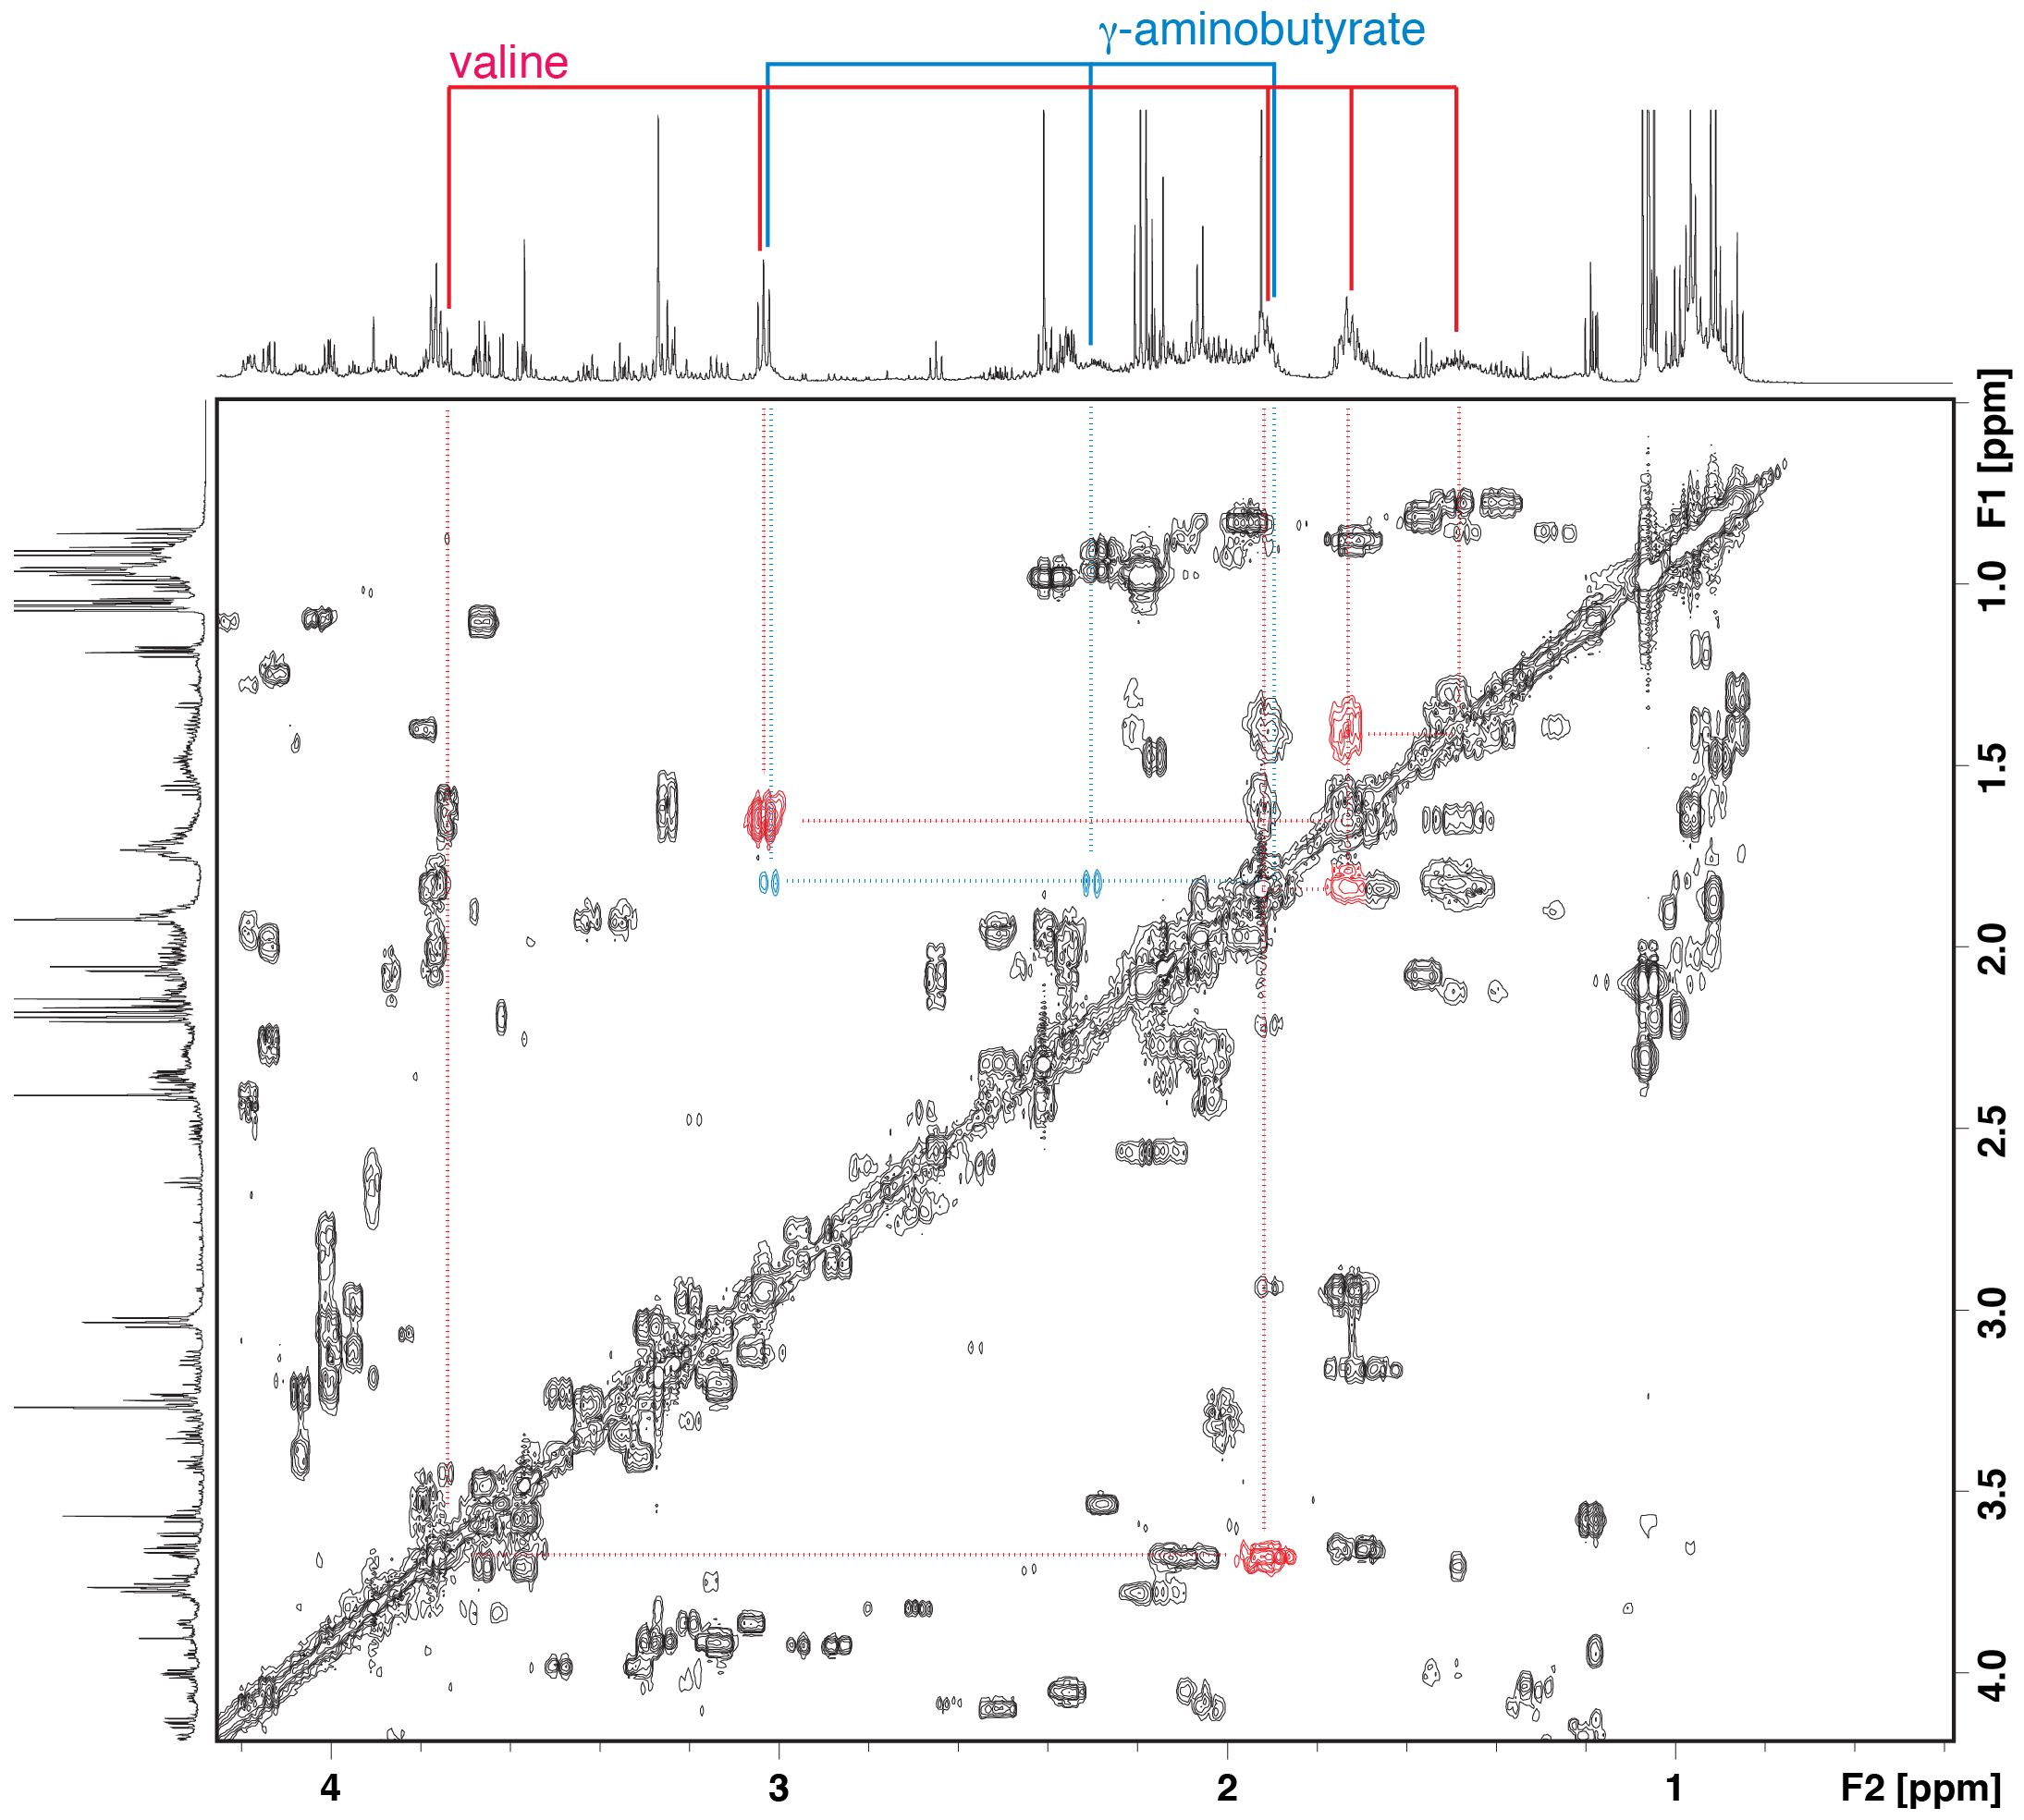
Where are the Stickland fermentation products?
5-aminovalerate, the product of proline reduction, overlaps with other metabolites within the NMR spectra.
We attempted identification of 5-aminovalerate in ASF356-ASF519 co-culture using 2D-NMR
The signal we thought might be 5-aminovalerate was actually gamma-aminobutyrate (AKA the neurotransmitter GABA)
Alternative hypotheses: 1) 5-aminovalerate is further degraded, or 2) Pro-Ala synergy is not due to Stickland fermentation
Medlock et al. Cell Systems 2018
Background | Aim 1: metabolic interactions | Aim 2: metabolic capabilities | Conclusions

Slide 55
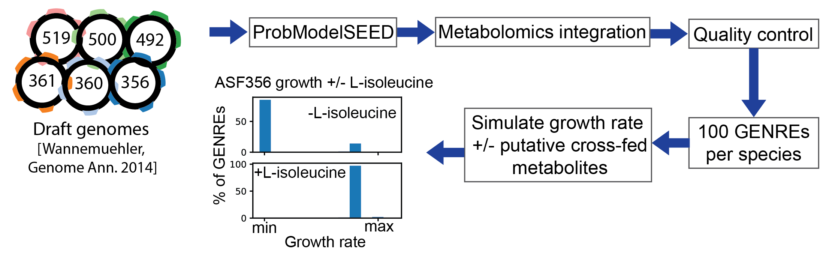
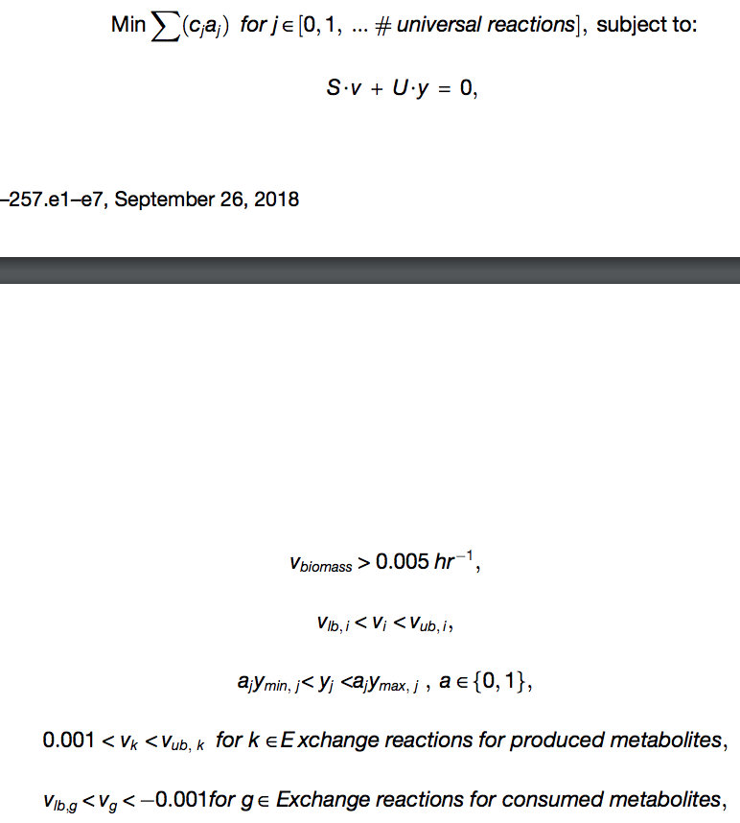
Notes:
One modeling strategy that is promising is genome-scale metabolic modeling. In genome-scale metabolic modeling, an organisms' genome is annotated with biochemical functions. Then, these annotations are assembled into a genome-scale metabolic network reconstruction, or GENRE, where the biochemical functions are connected to each other. This GENRE can then be represented mathematically, forming a stoichiometric matrix that allows numerical methods to be applied to the system. In practice, objective functions are also defined, such as production of biomass from metabolic precursors, in order to simulate biological objectives, such as maximizing growth. Numerical optimization can then be applied to model this maximization of a biological objective and find the network states, in this case reaction fluxes, that allow that maximum value to occur.
GENREs are well-suited to study gut microbes because they take environmental context into account. Just as the environment within the human gut is constantly changing as a function of diet, the metabolites available for uptake for an organism can be precisely controlled with a GENRE. GENREs also allow explicit modeling of interactions between species. Various methods have been developed to simulate these interactions, however none have been validated. The last primary benefit of using a GENRE to study gut microbes is that they provide a platform to accelerate the discovery of genes of unknown function. When data are collected, they can be compared to in silico predictions, and the GENRE can be used to evaluate whether putative novel functions improve the concordance of the GENRE with the observations collected.

Slide 56
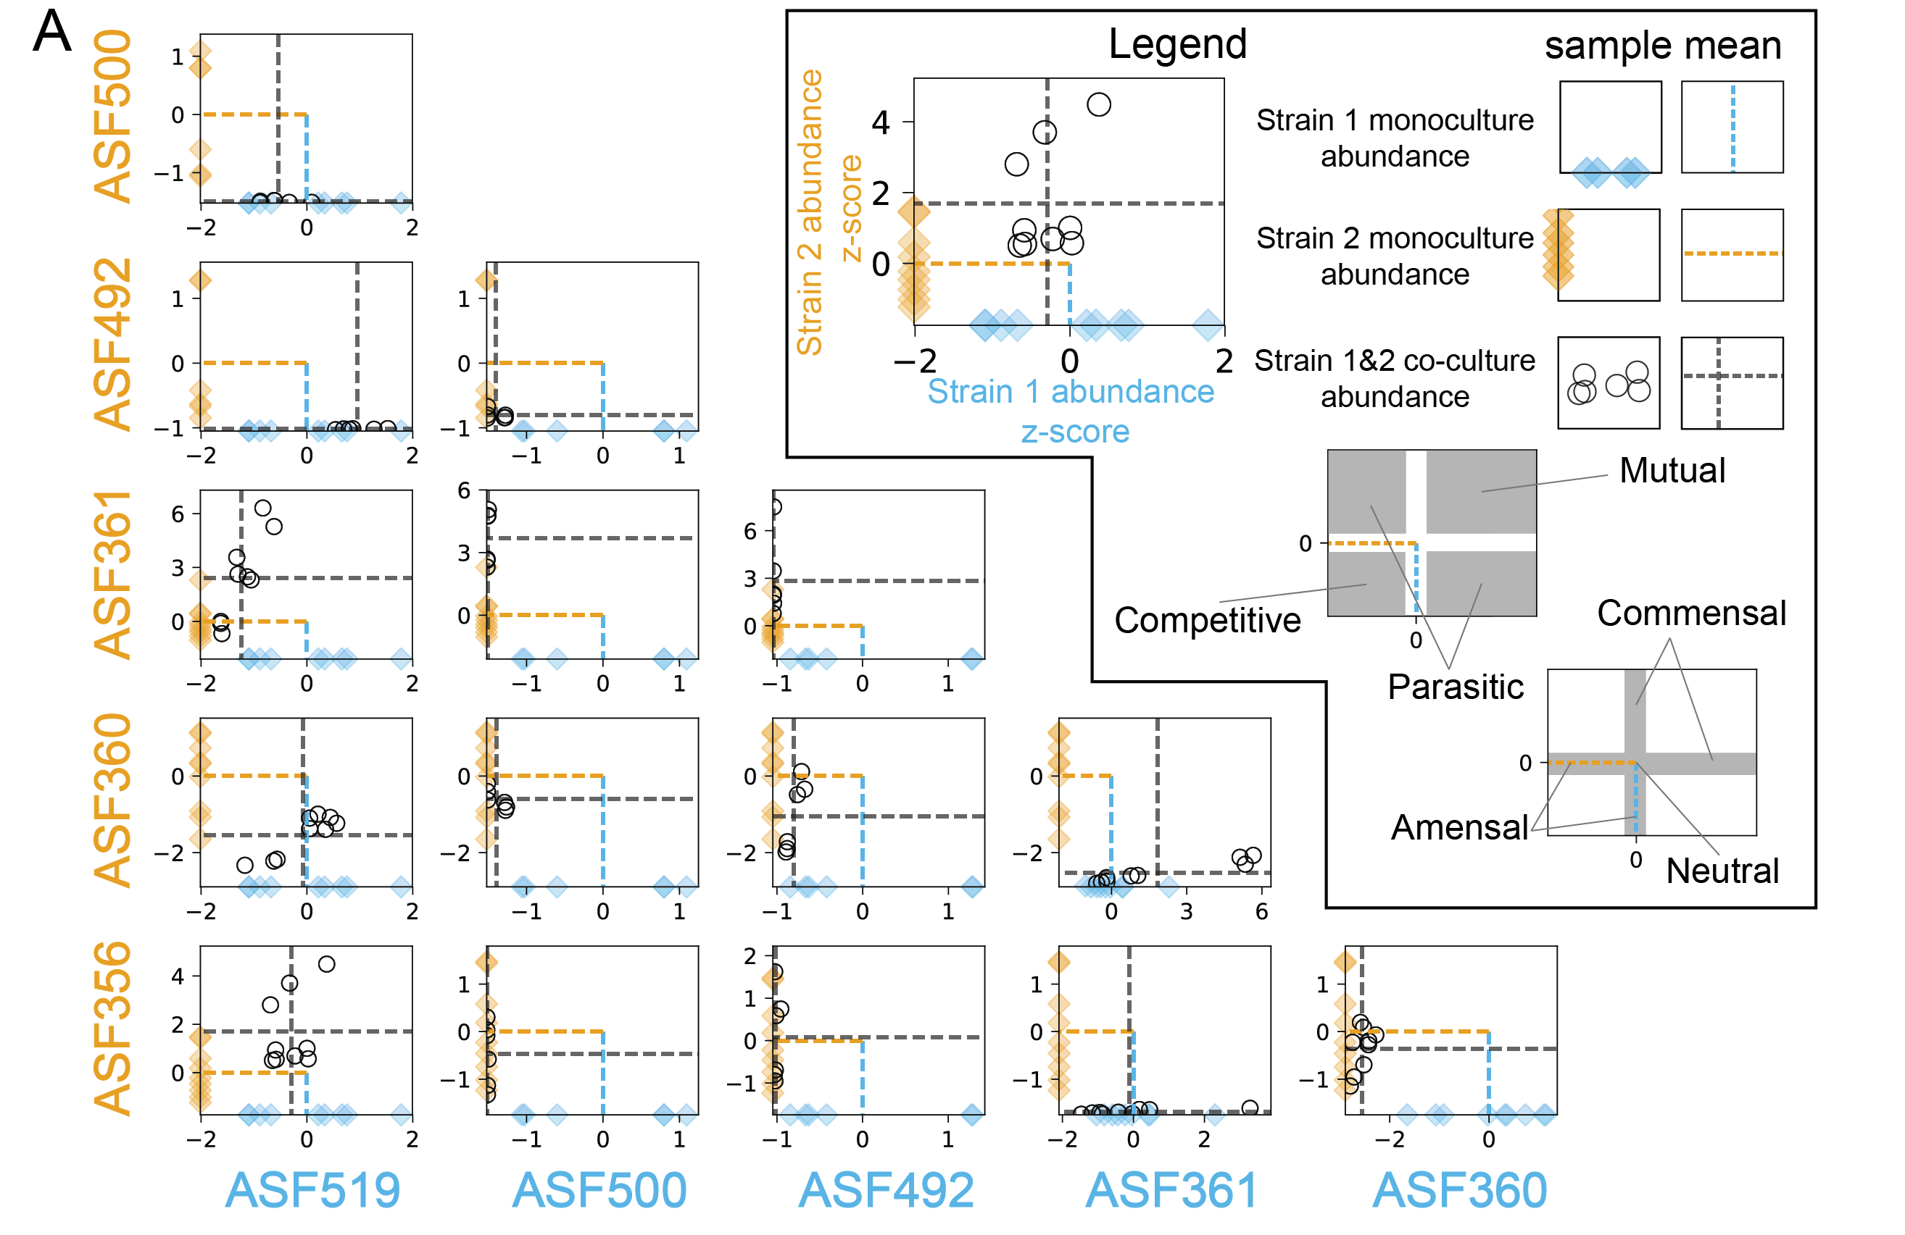
Medlock et al. Cell Systems 2018
Background | Aim 1: metabolic interactions | Aim 2: metabolic capabilities | Conclusions

Slide 57
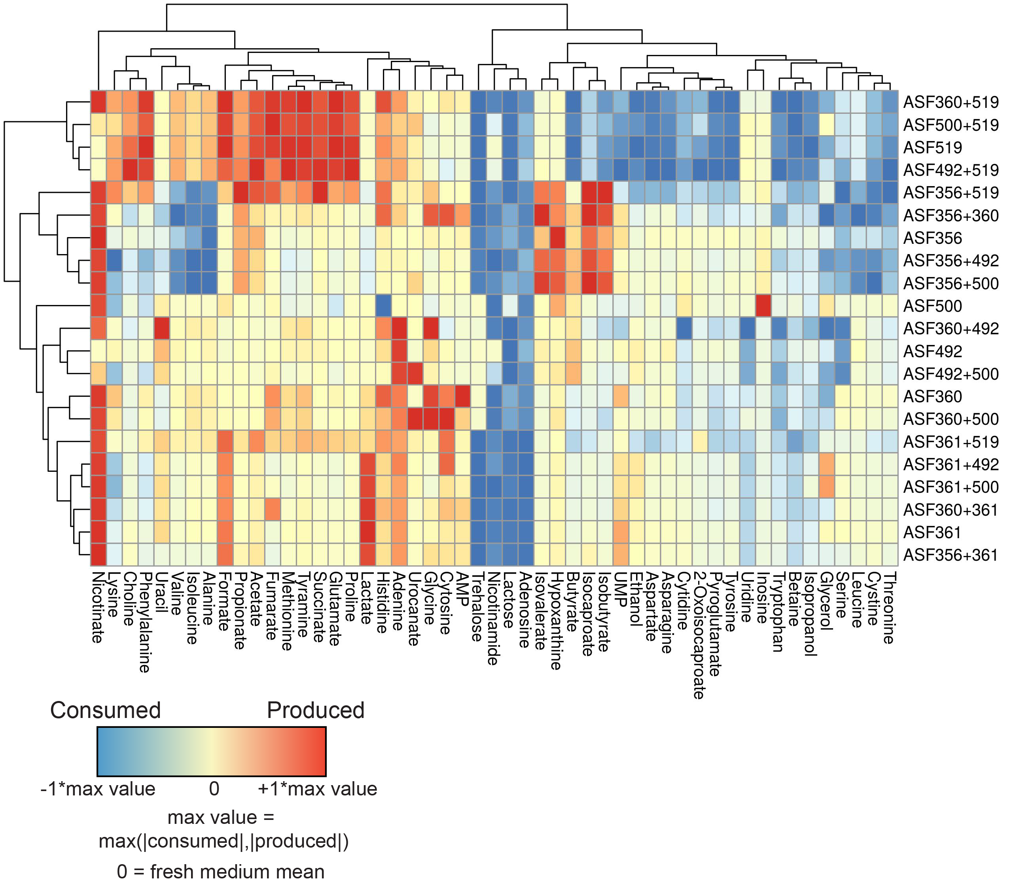
Medlock et al. Cell Systems 2018
Background | Aim 1: metabolic interactions | Aim 2: metabolic capabilities | Conclusions

Slide 58
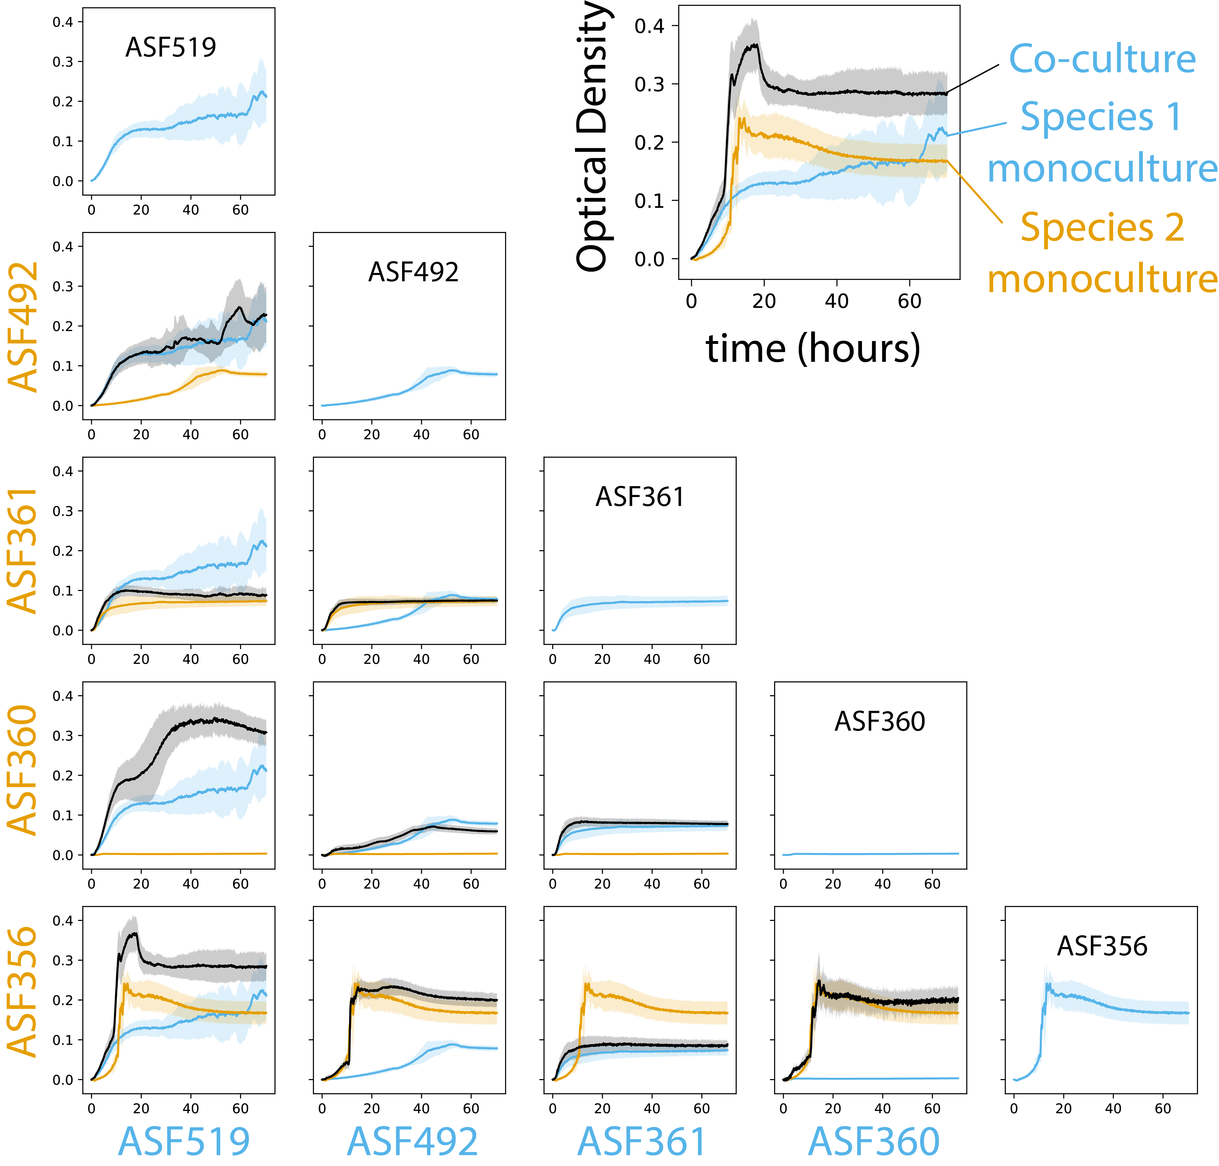
Medlock et al. Cell Systems 2018
Background | Aim 1: metabolic interactions | Aim 2: metabolic capabilities | Conclusions

Slide 59
Does this process make models more accurate?
Compared predictive abilities of each simulation cluster against experimental data
Selecting one cluster of models improves performance
Background | Aim 1: metabolic interactions | Aim 2: metabolic capabilities | Conclusions

Slide 60
Genome-scale metabolic network reconstructions (GENREs)
GENREs are well suited for studying gut microbes because:
They take environmental context into account
They allow modeling of interactions between species
They can be constructed from sequence data alone (i.e. clinical + in vivo relevance)
Background | Aim 1: metabolic interactions | Aim 2: metabolic capabilities | Conclusions
Notes:
One modeling strategy that is promising is genome-scale metabolic modeling. In genome-scale metabolic modeling, an organisms' genome is annotated with biochemical functions. Then, these annotations are assembled into a genome-scale metabolic network reconstruction, or GENRE, where the biochemical functions are connected to each other. This GENRE can then be represented mathematically, forming a stoichiometric matrix that allows numerical methods to be applied to the system. In practice, objective functions are also defined, such as production of biomass from metabolic precursors, in order to simulate biological objectives, such as maximizing growth. Numerical optimization can then be applied to model this maximization of a biological objective and find the network states, in this case reaction fluxes, that allow that maximum value to occur.
GENREs are well-suited to study gut microbes because they take environmental context into account. Just as the environment within the human gut is constantly changing as a function of diet, the metabolites available for uptake for an organism can be precisely controlled with a GENRE. GENREs also allow explicit modeling of interactions between species. Various methods have been developed to simulate these interactions, however none have been validated. The last primary benefit of using a GENRE to study gut microbes is that they provide a platform to accelerate the discovery of genes of unknown function. When data are collected, they can be compared to in silico predictions, and the GENRE can be used to evaluate whether putative novel functions improve the concordance of the GENRE with the observations collected.

